Slide 1
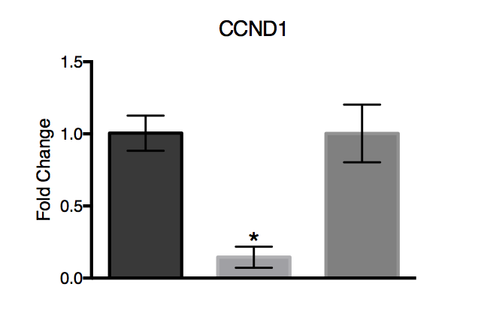
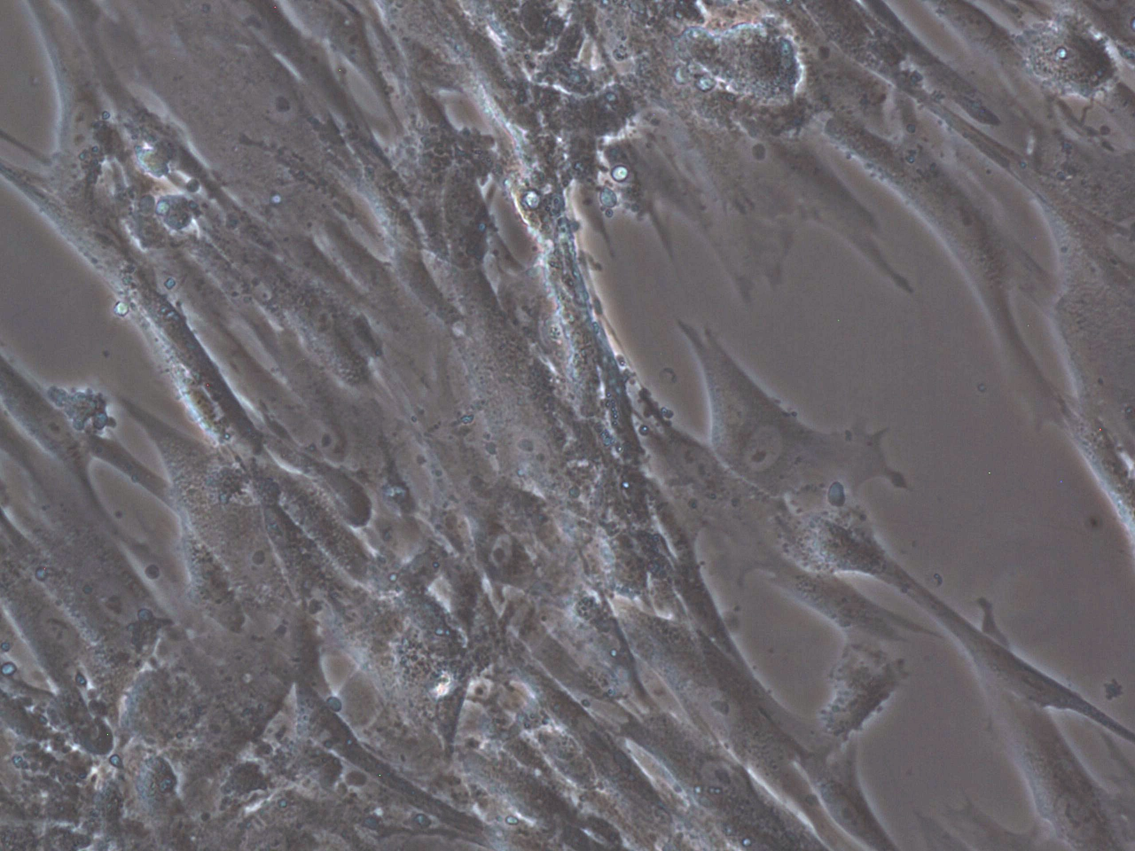
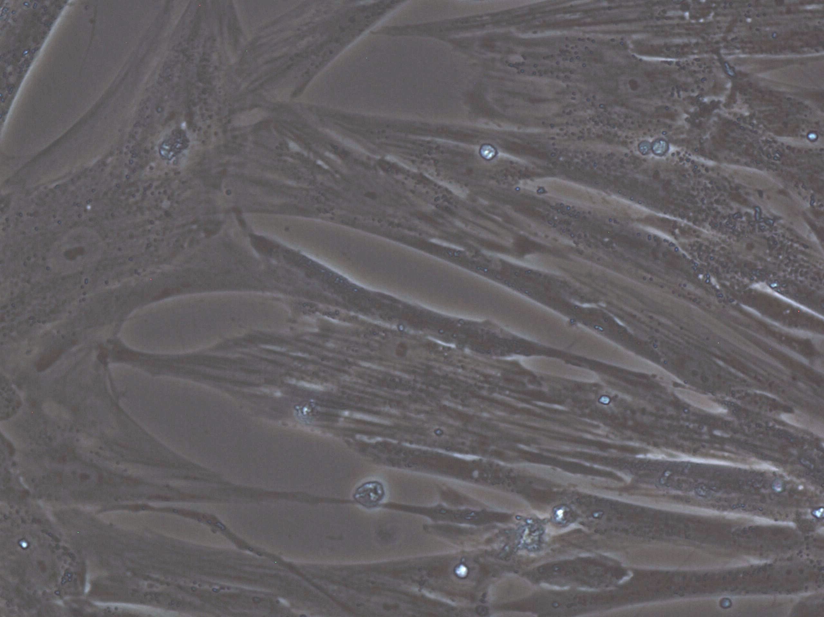
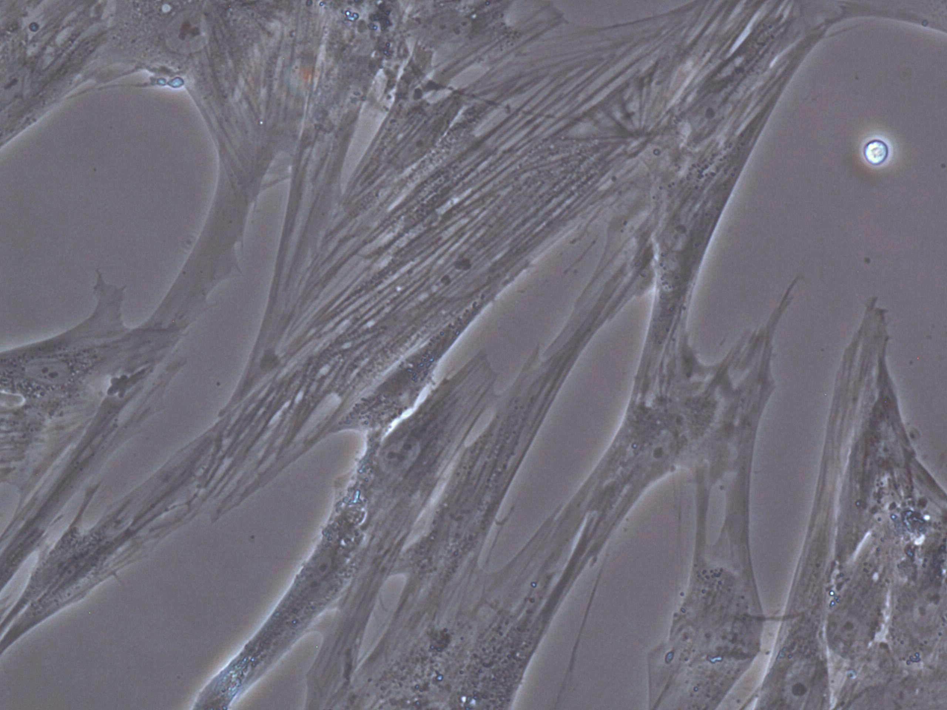
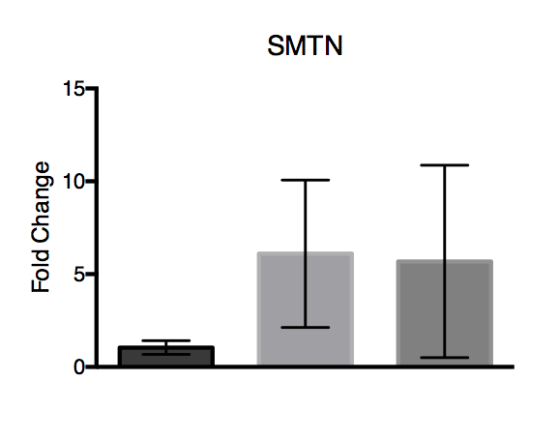
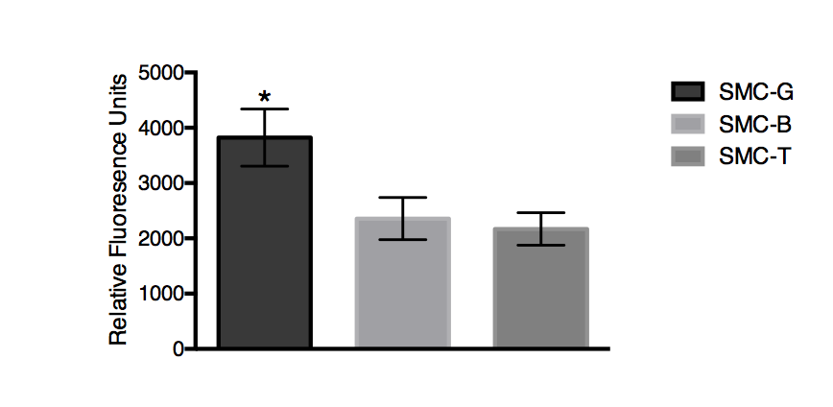
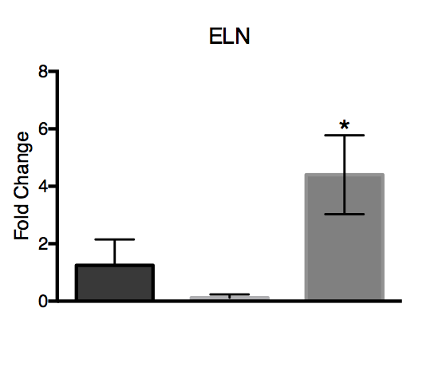
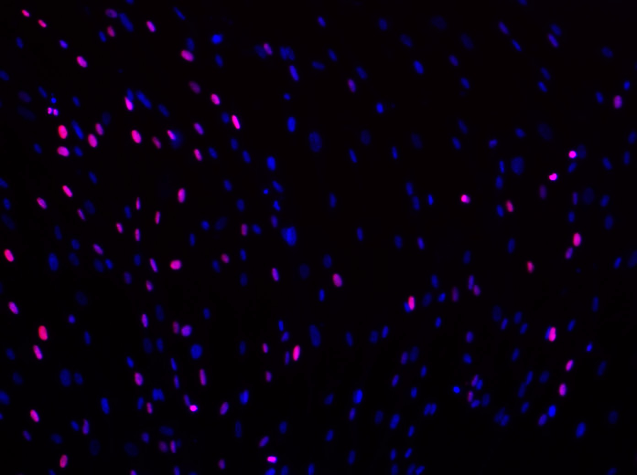
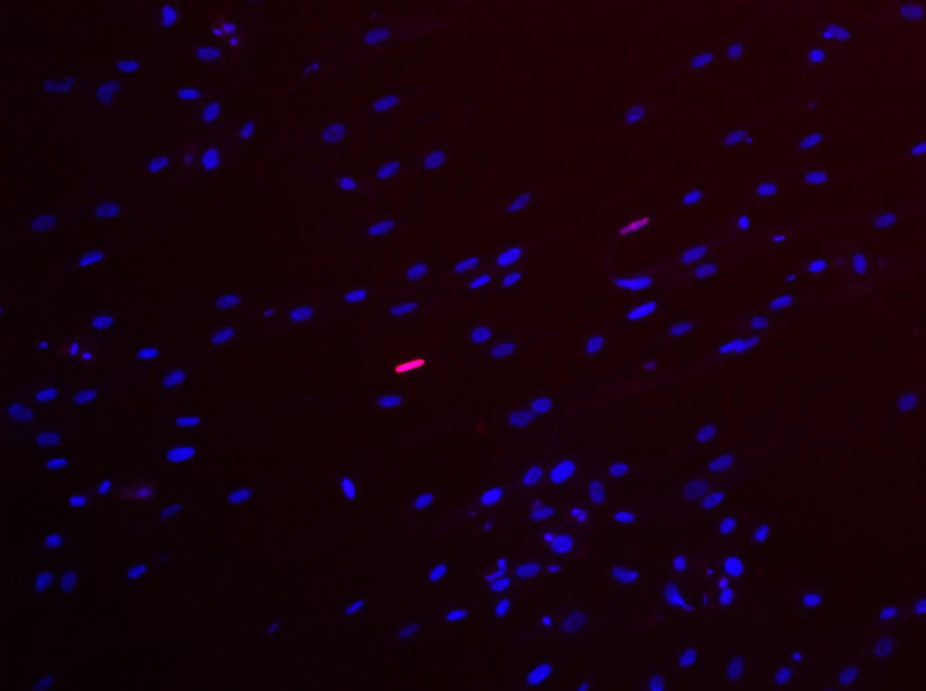
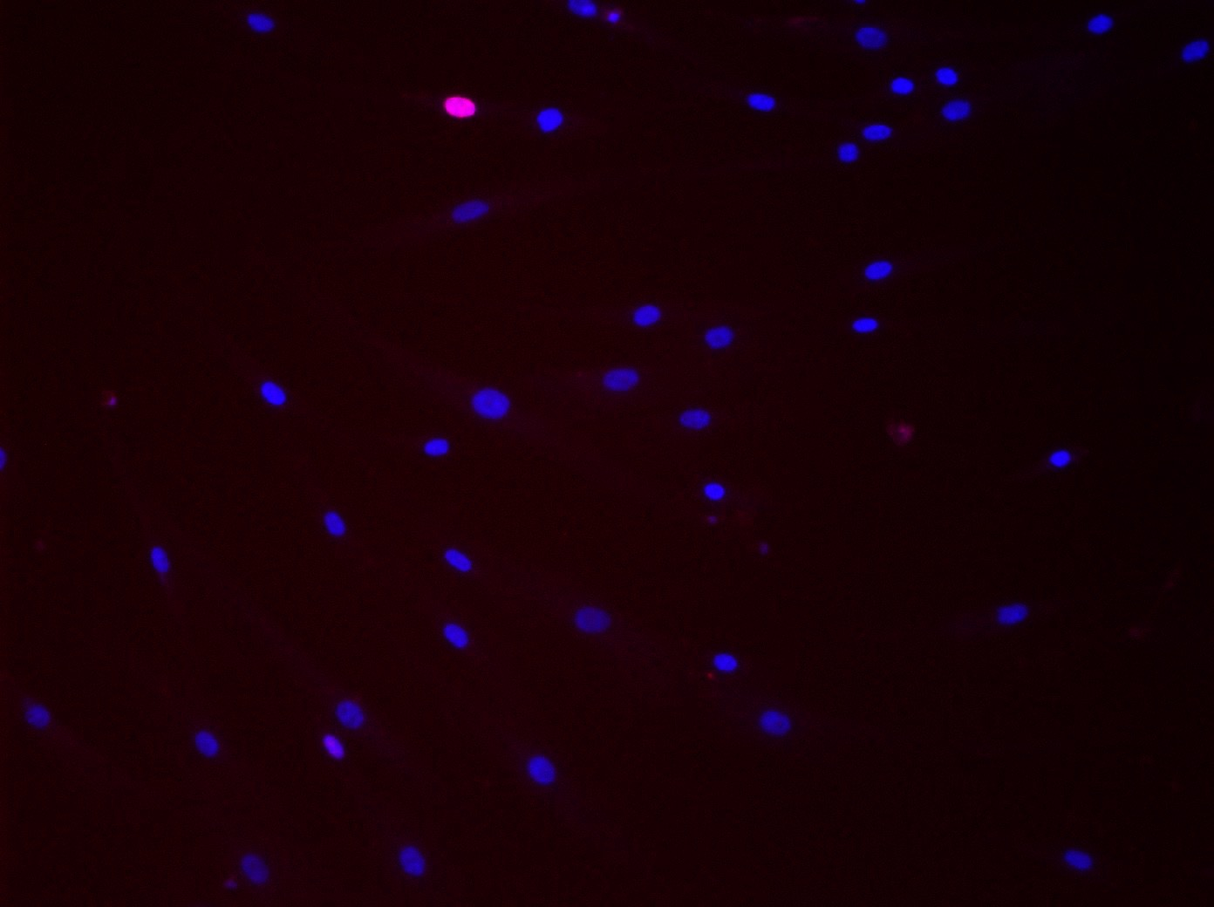
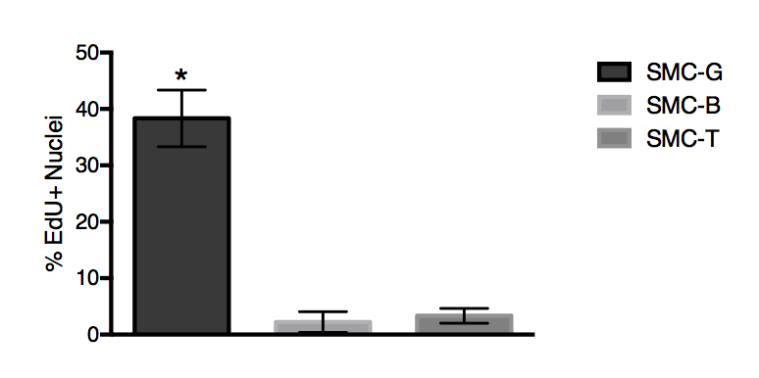
A
SMC-T
SMC-G
SMC-B
B
Figure 1. Characterization of G, B, and T hUASMCs on day 4. A) Bright field images showing morphology at 4X magnification
A
SMC-T
SMC-G
SMC-B
B
Figure 2. Characterization of G, B, and T hUASMCs on day 4. A) Bright field images showing morphology at 4X magnification
Notes:
20x BF
Rid lines/chartjunk
20x and RFU 1 fig, EDU images A and then graph B in fig2, protein exp fig 3, gene expression fig 4

Slide 2
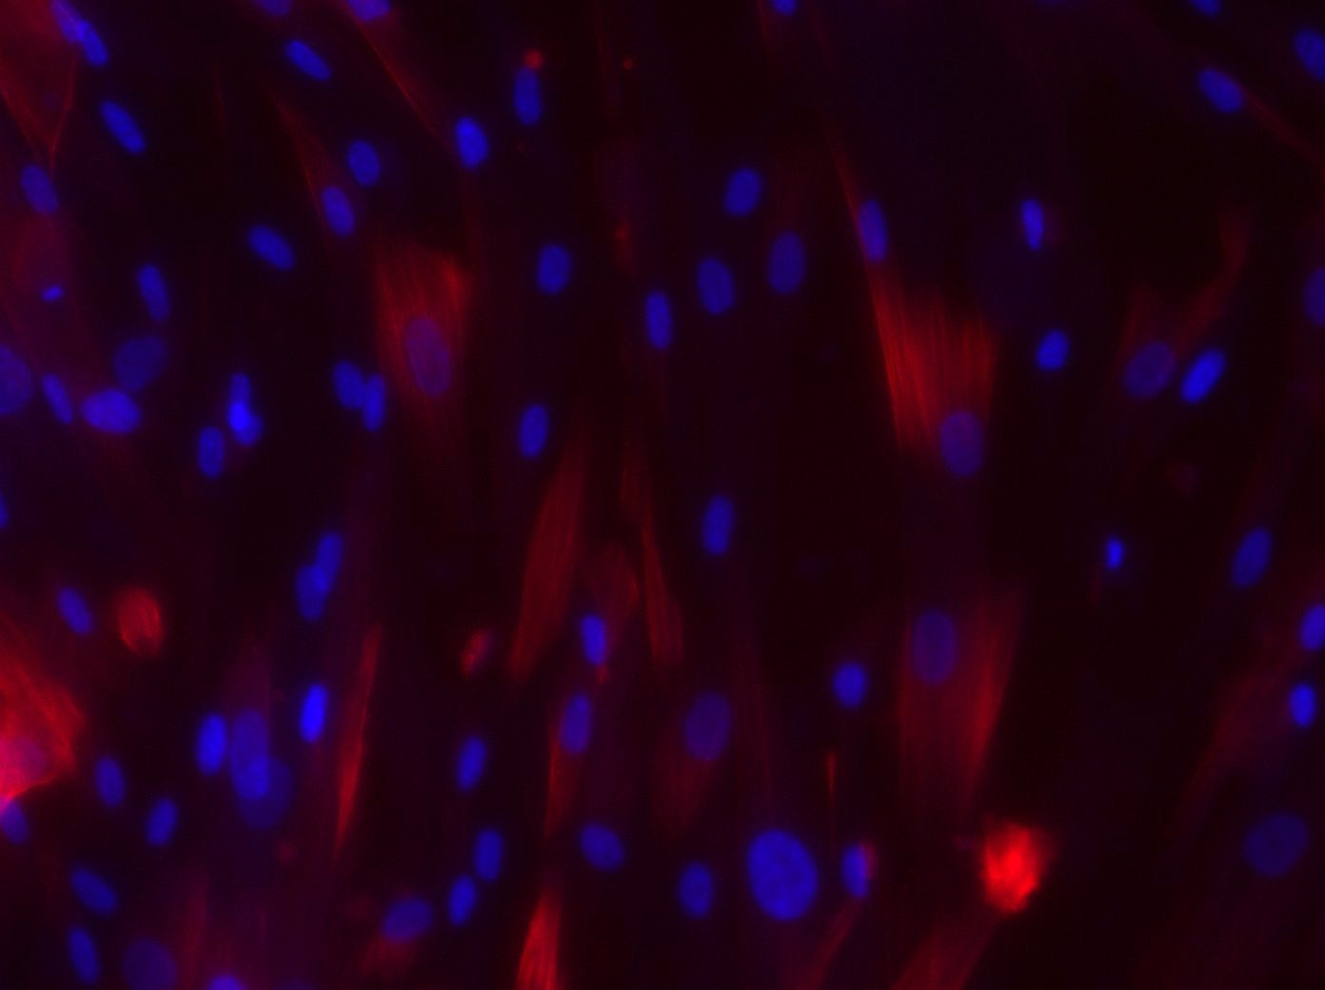
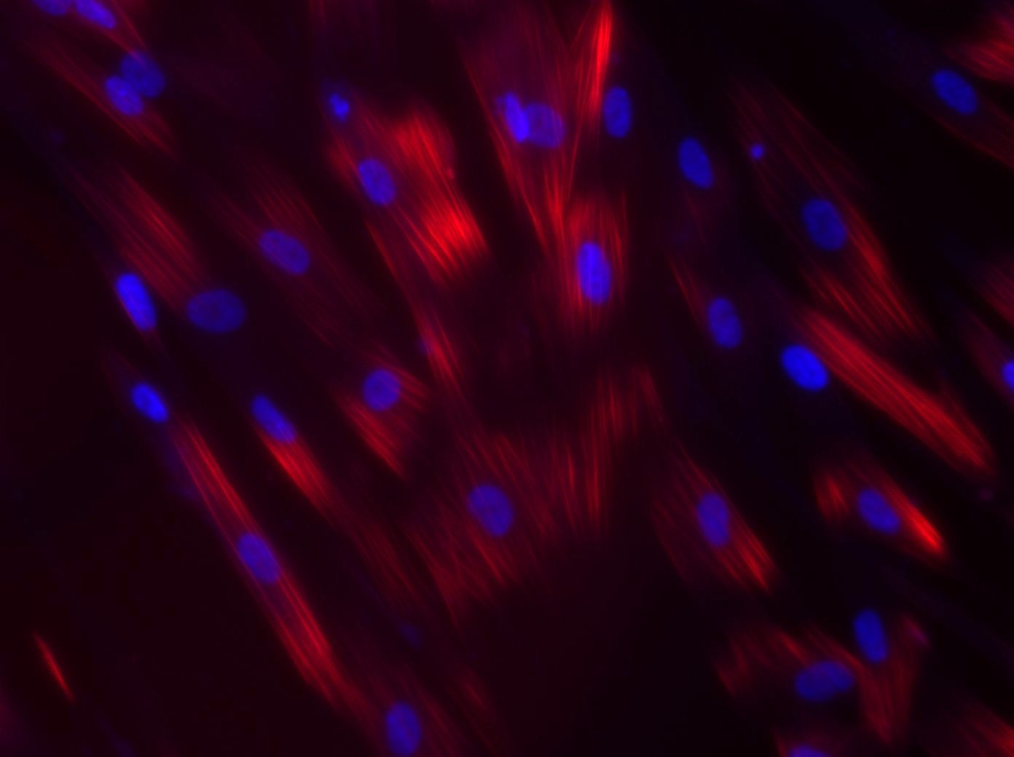
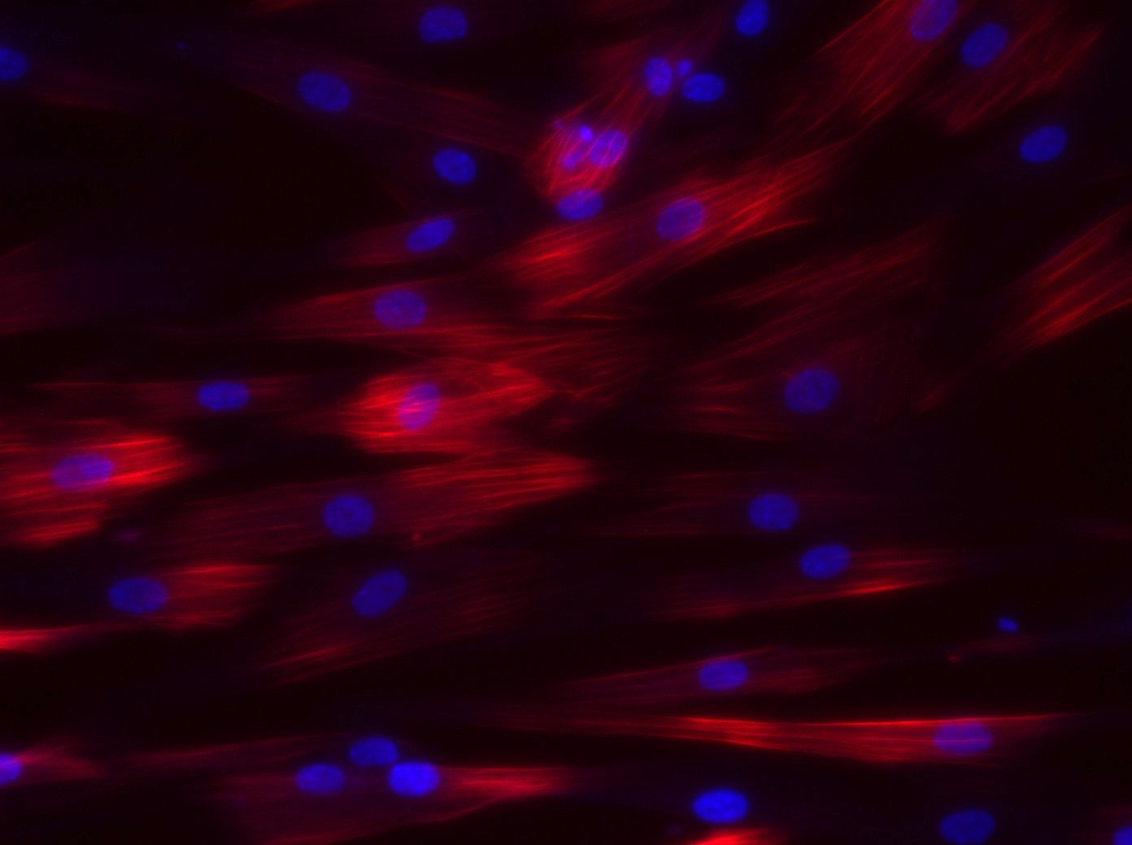
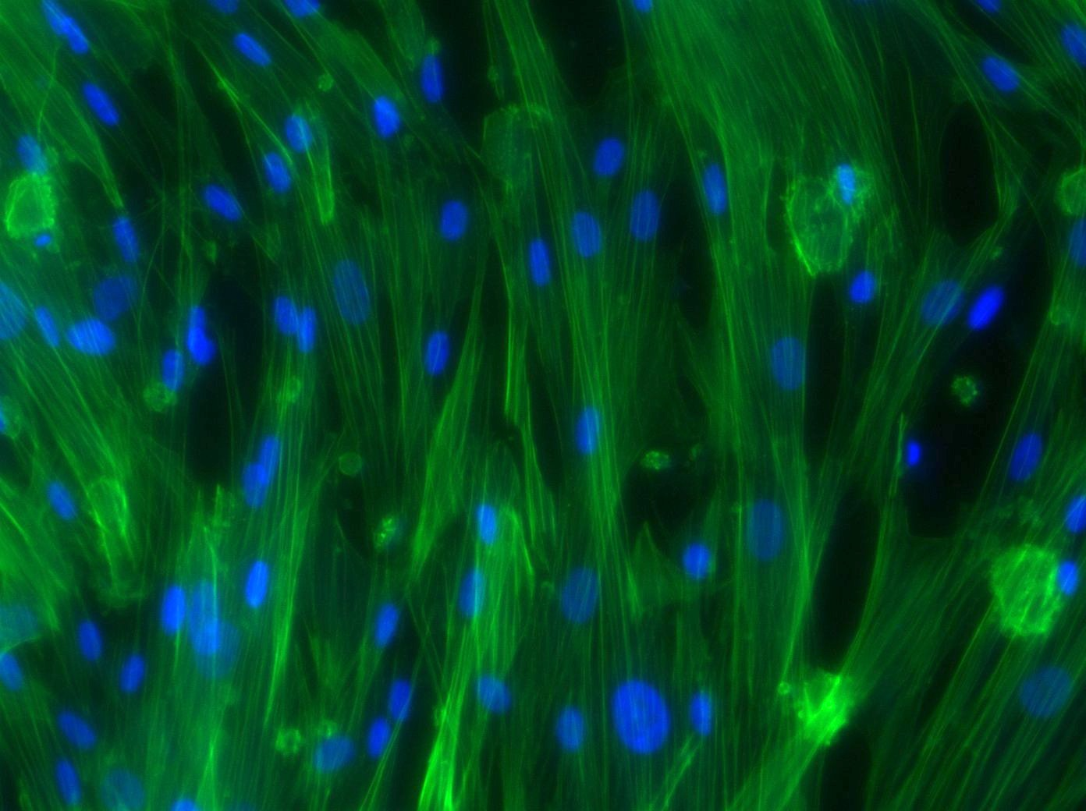
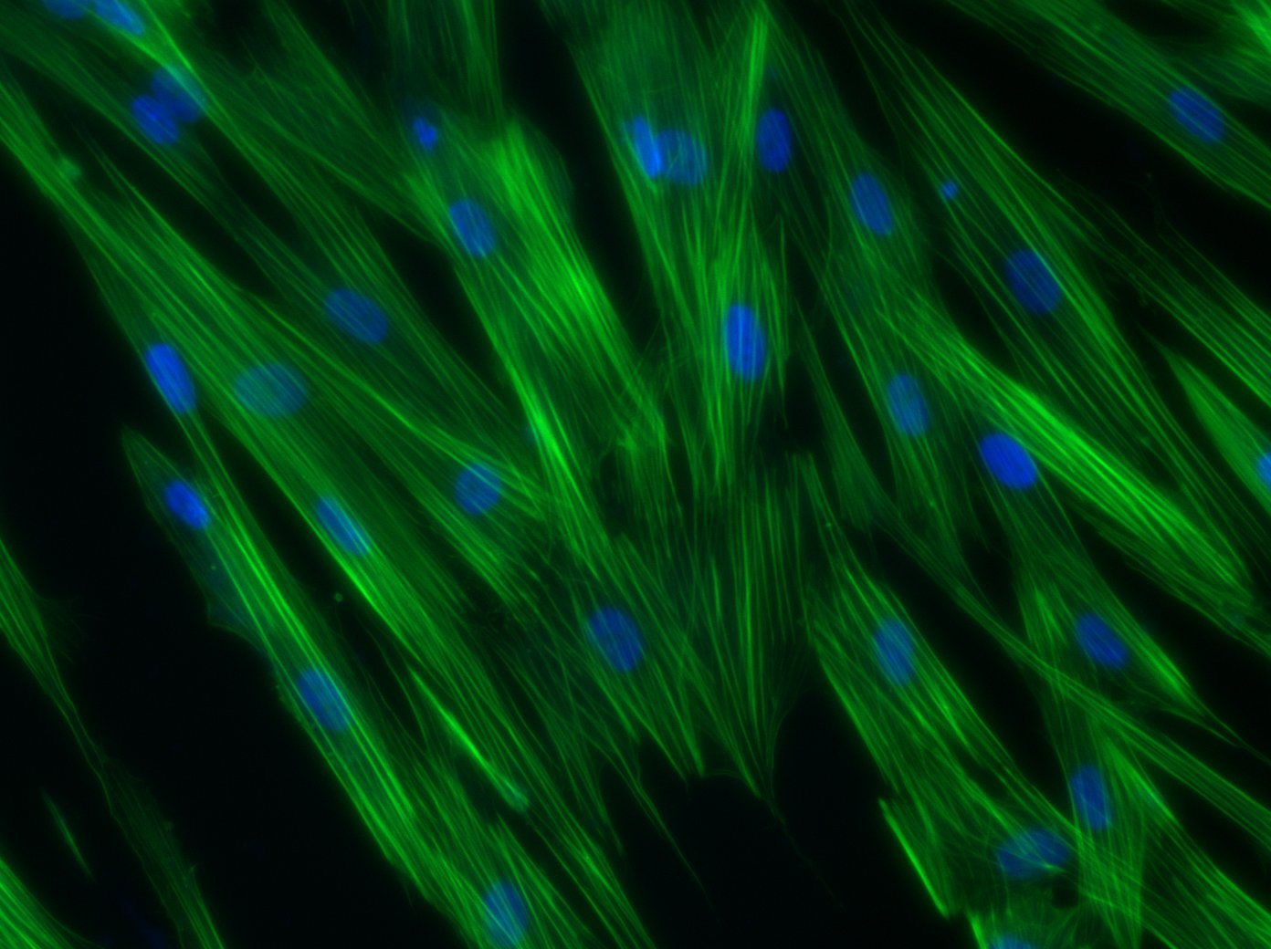
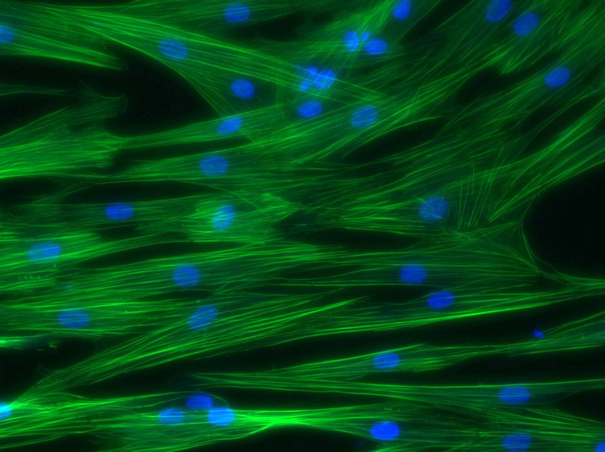
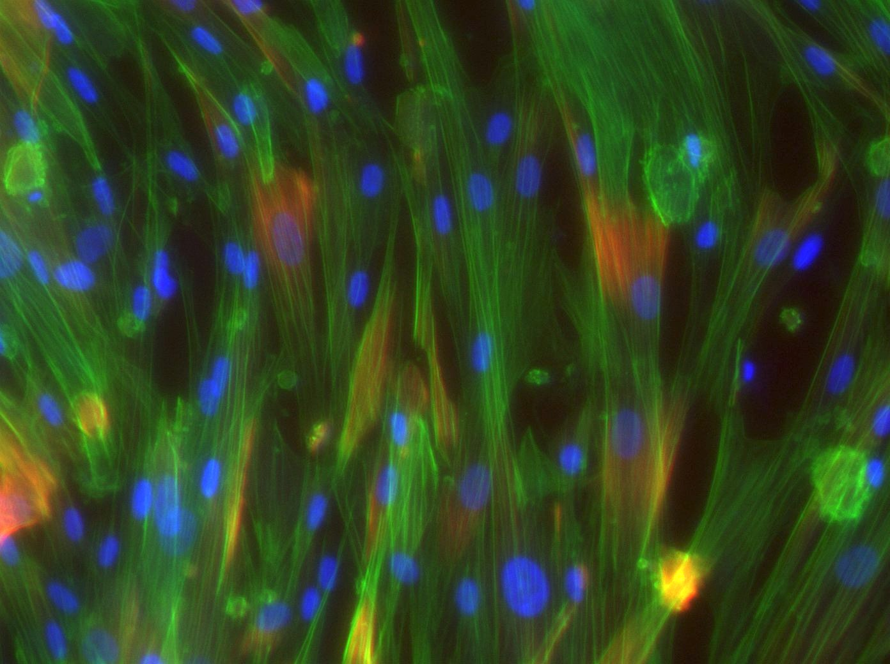
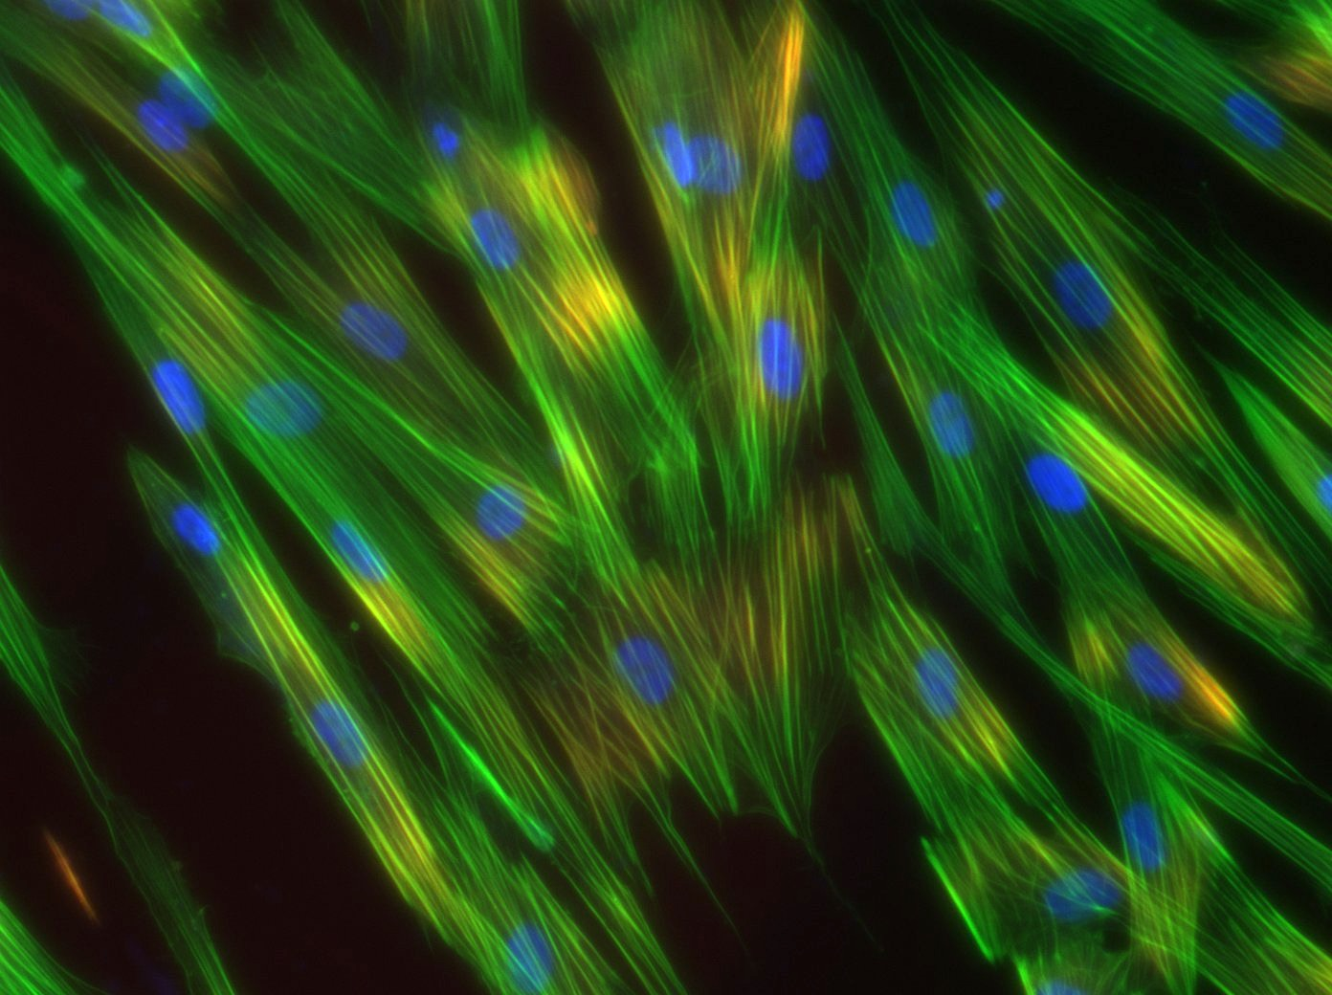
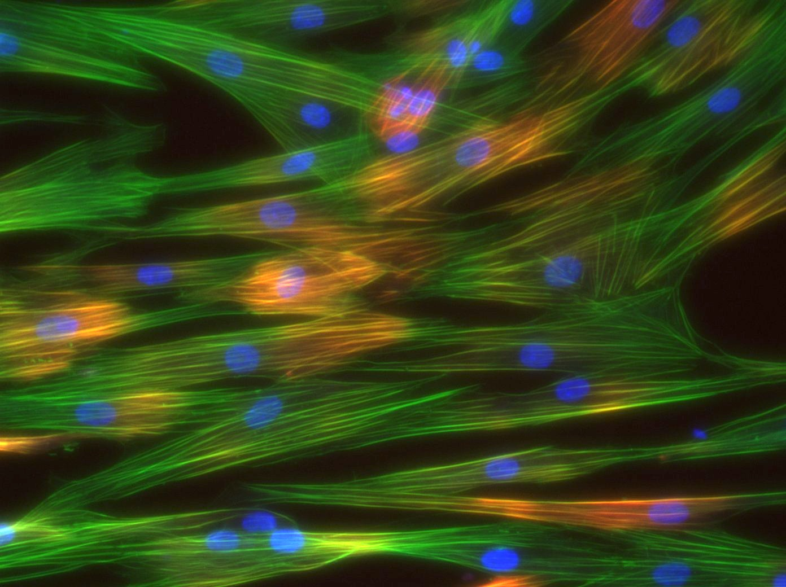
SMC-G
SMC-B
SMC-T
Figure 3. Cells were stained for calponin (red, top & bottom), phalloidin (green, middle & bottom), and DAPI (blue) and imaged at 20X magnification
Figure 4. Cells were stained for calponin (red, top & bottom), phalloidin (green, middle & bottom), and DAPI (blue) and imaged at 20X magnification

Slide 3
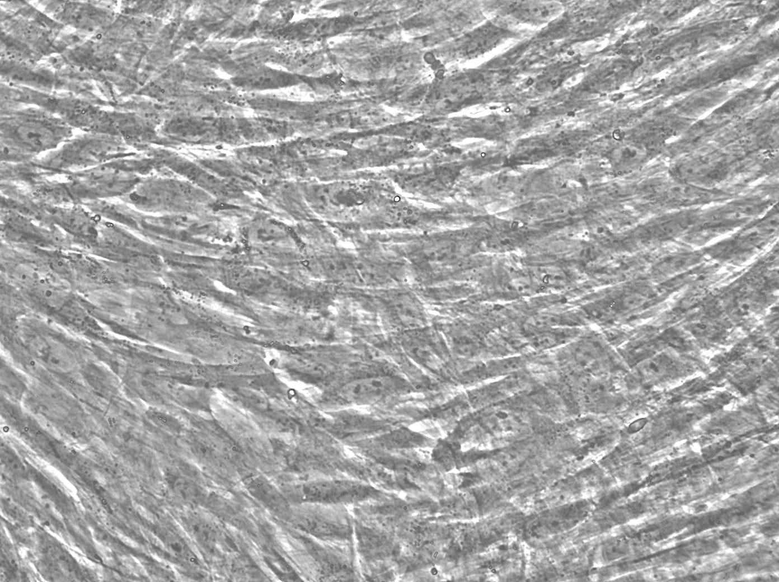
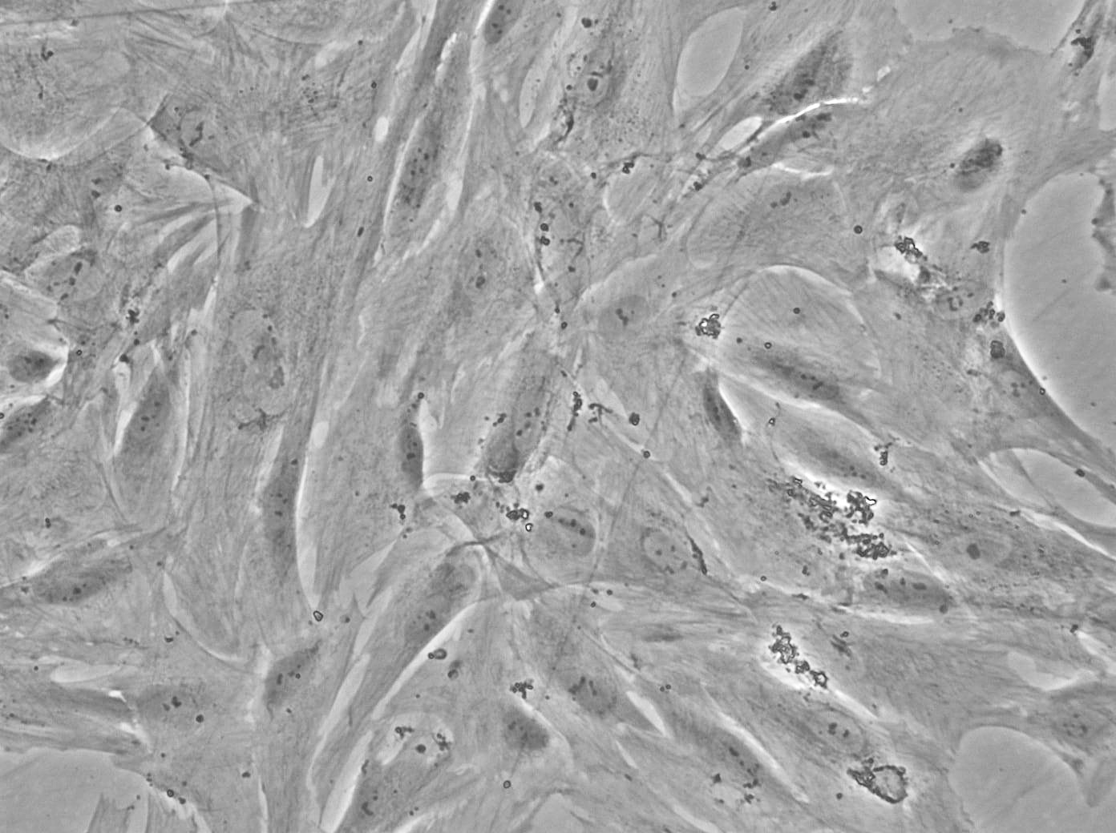
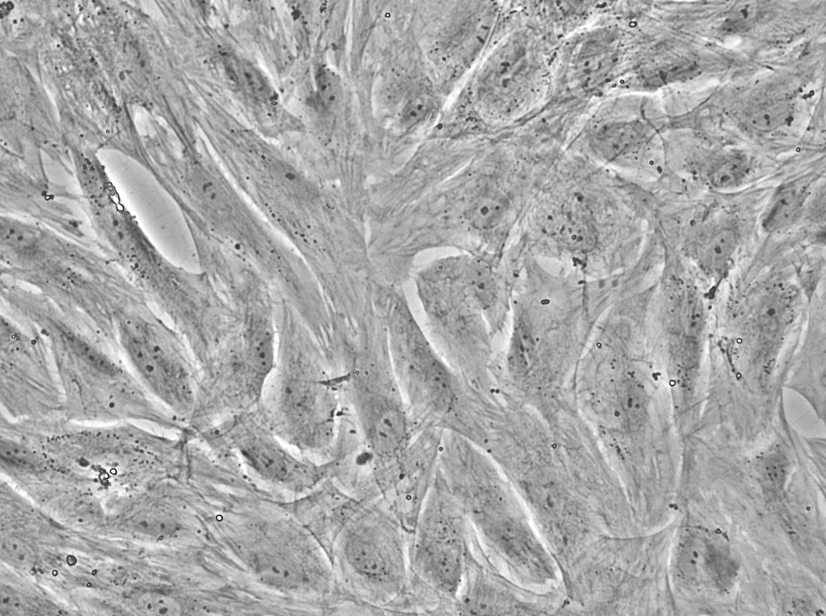
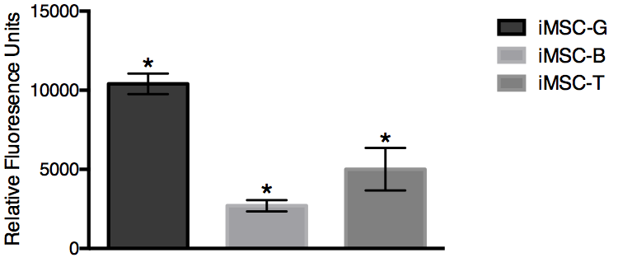
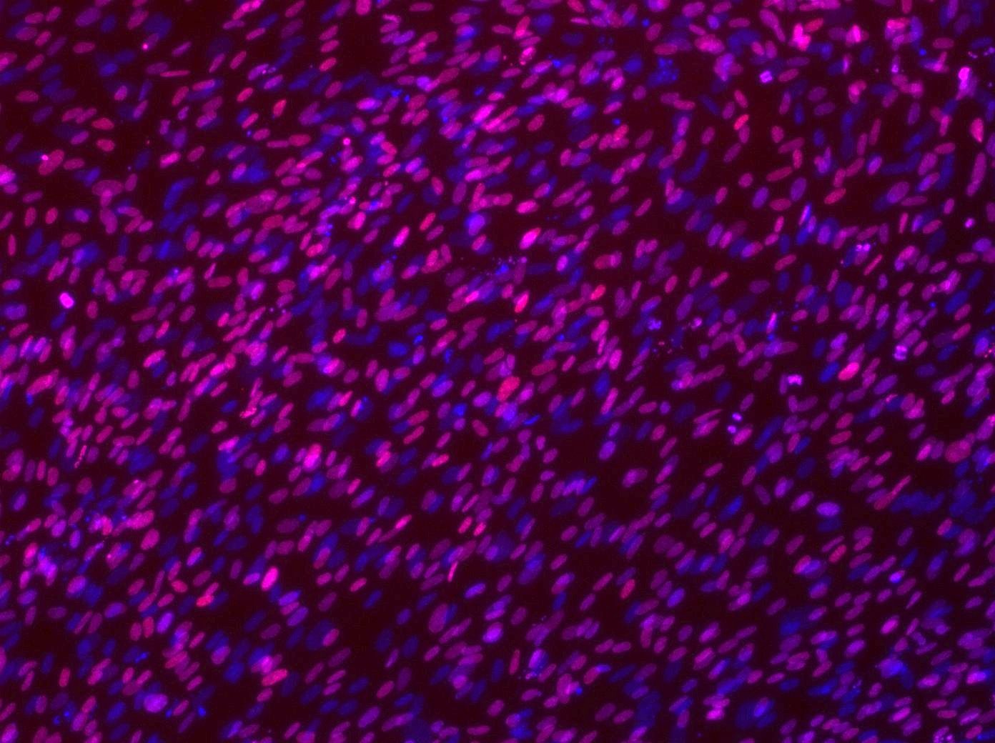
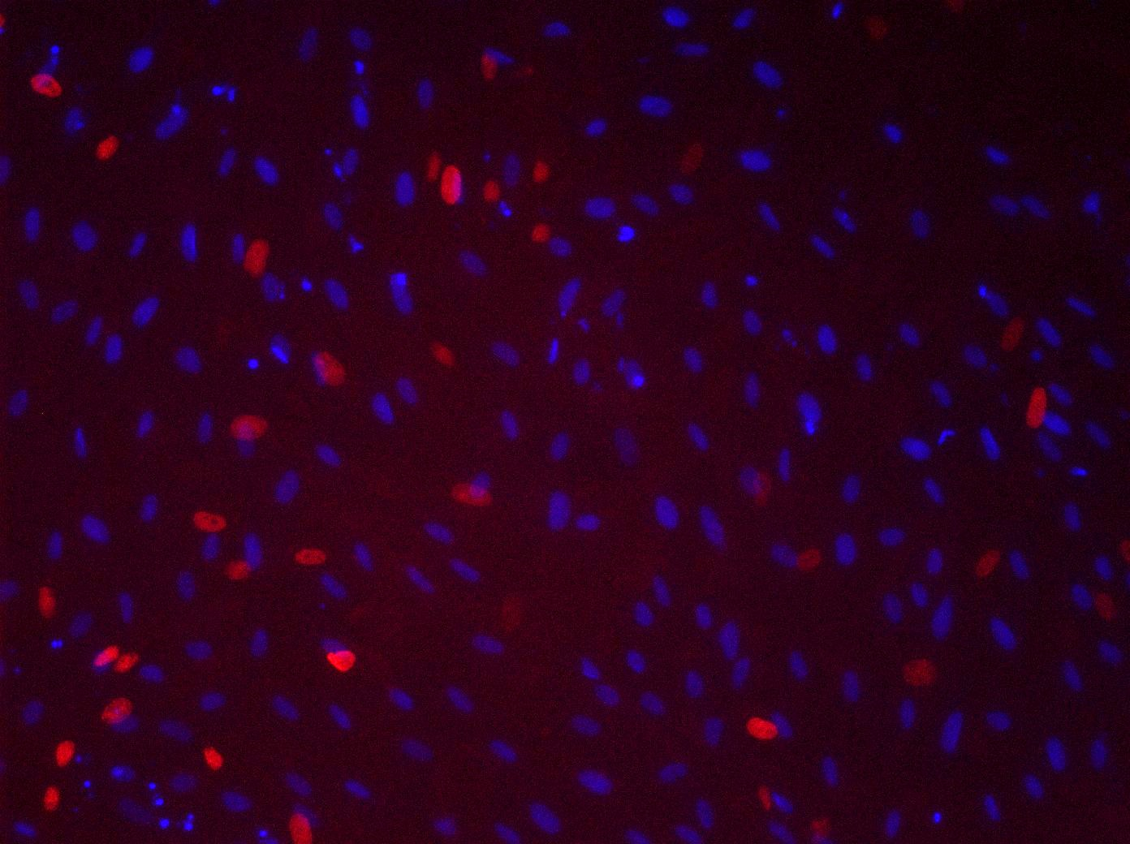
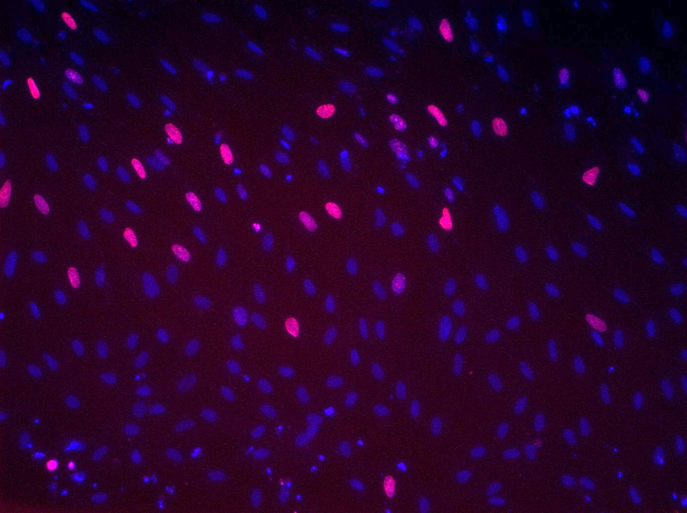
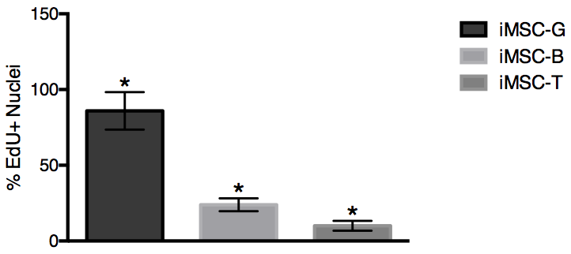
A
iMSC-T
iMSC-G
iMSC-B
B
Figure 1. Characterization of G, B, and T hUASMCs on day 4. A) Bright field images showing morphology at 4X magnification
A
iMSC-G
iMSC-T
iMSC-B
B
Figure 2. Characterization of G, B, and T hUASMCs on day 4. A) Bright field images showing morphology at 4X magnification
Notes:
20x BF
Rid lines/chartjunk
20x and RFU 1 fig, EDU images A and then graph B in fig2, protein exp fig 3, gene expression fig 4

Slide 4
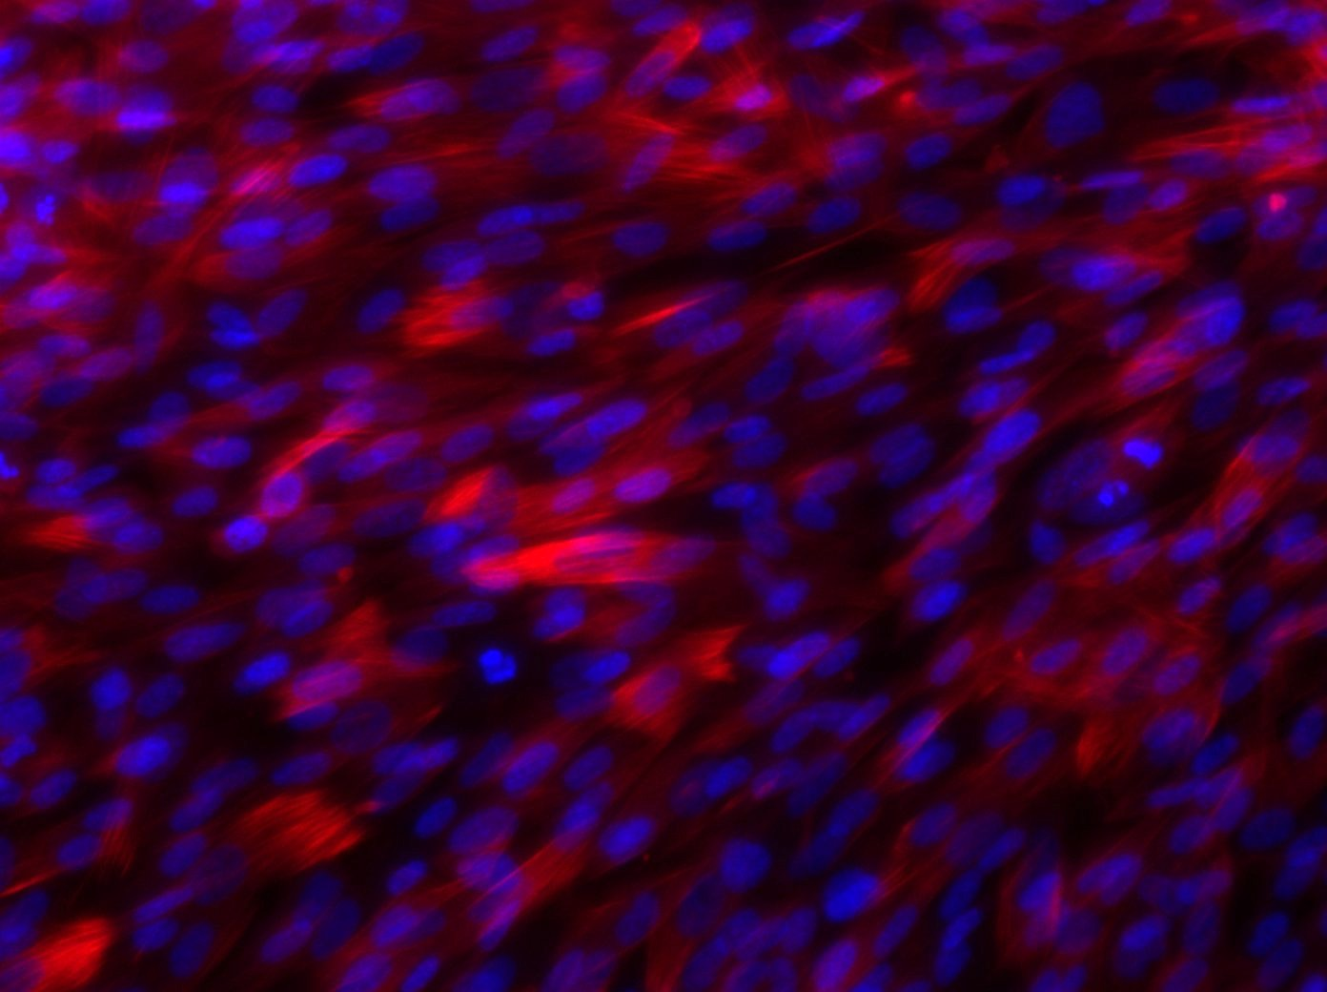
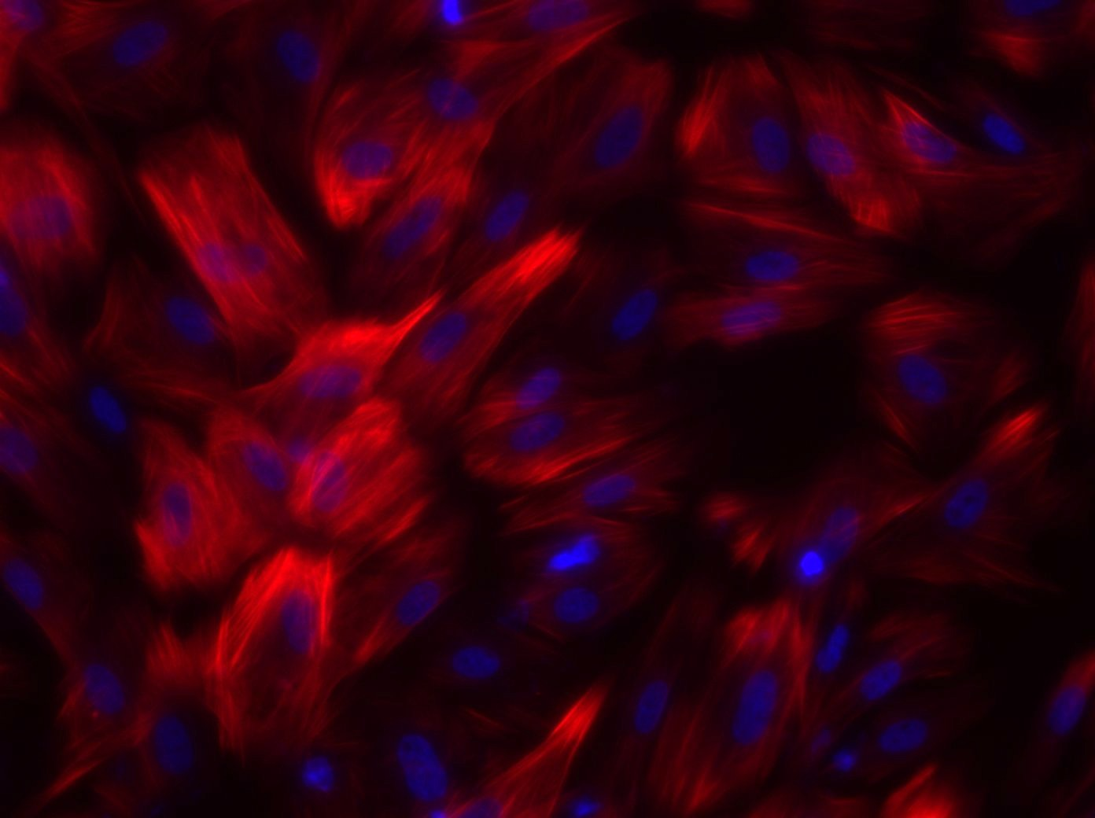
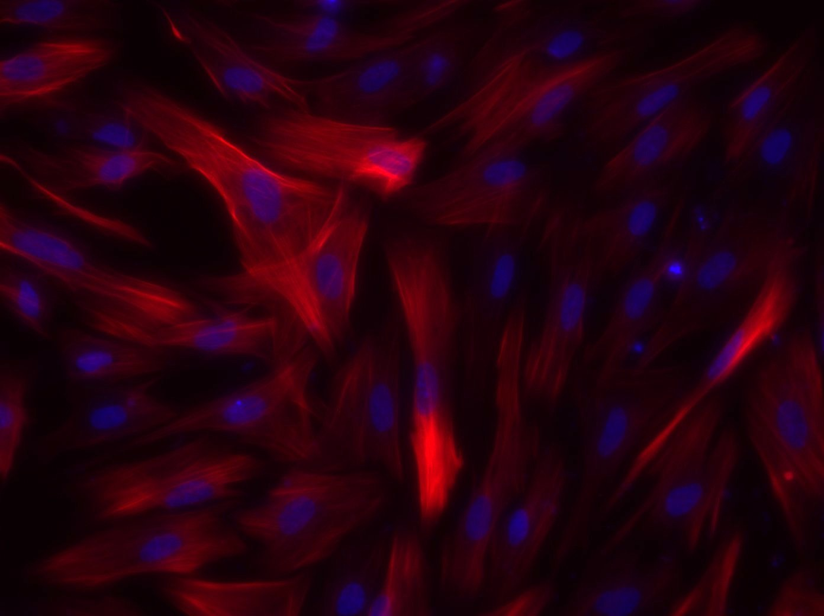
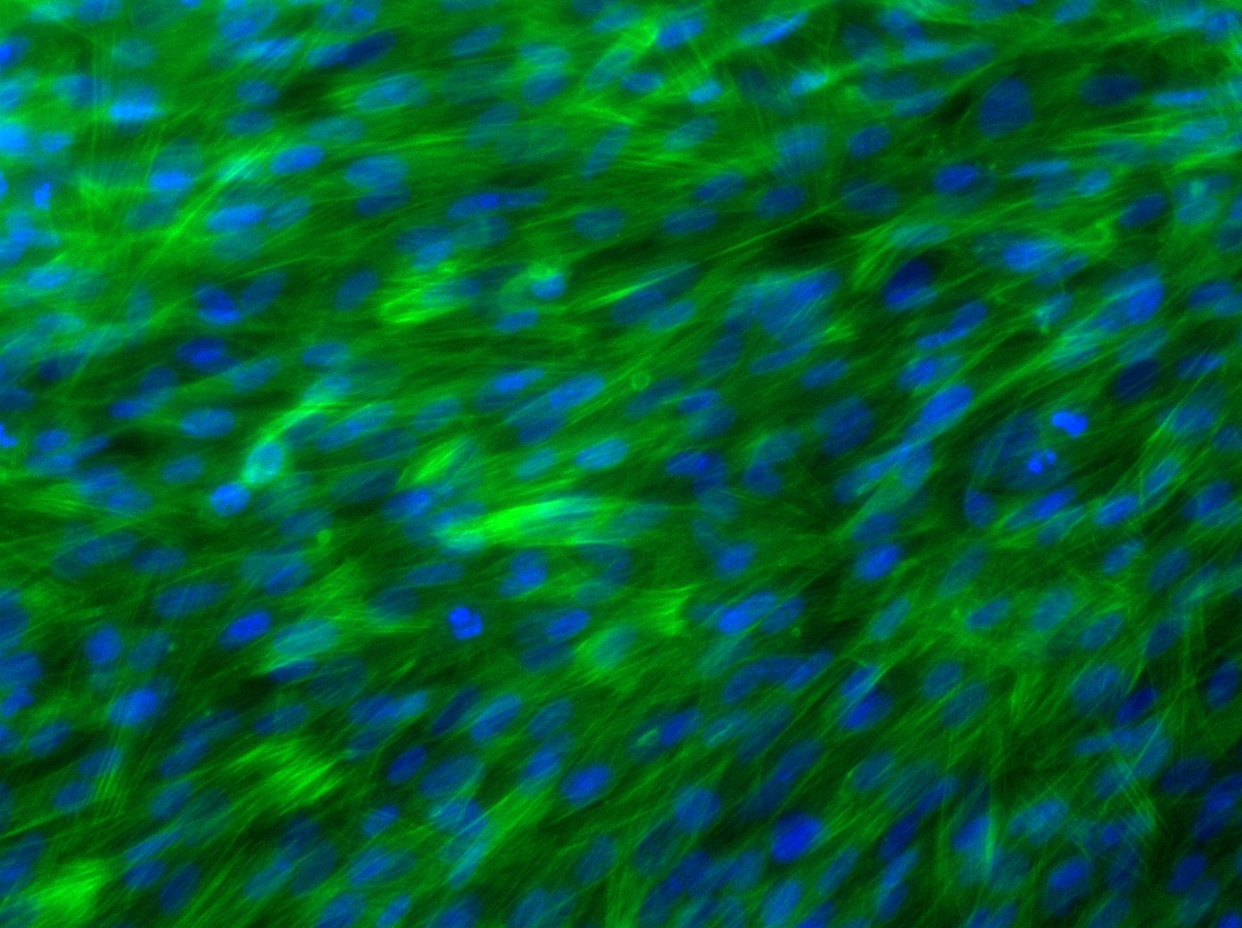
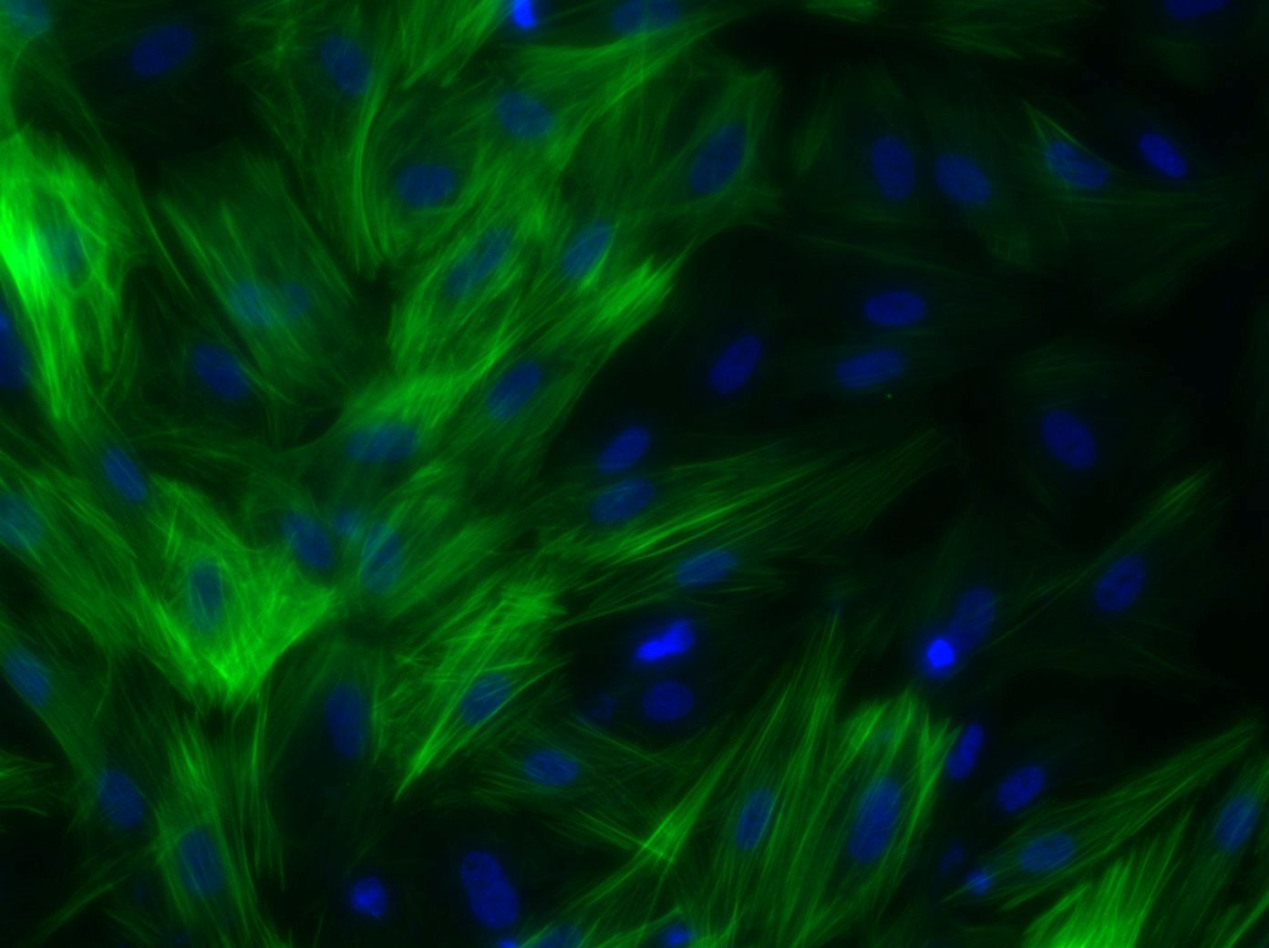
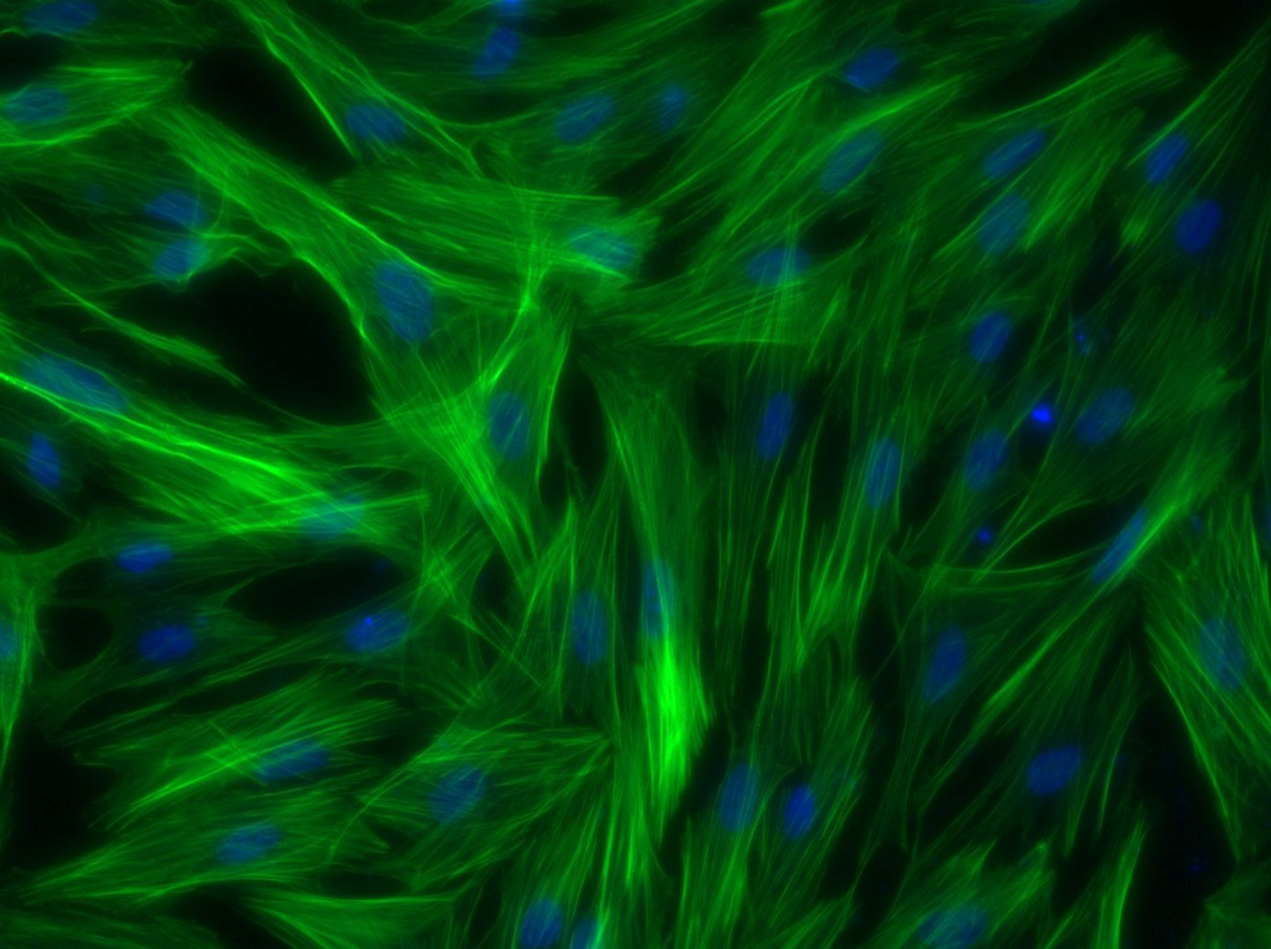
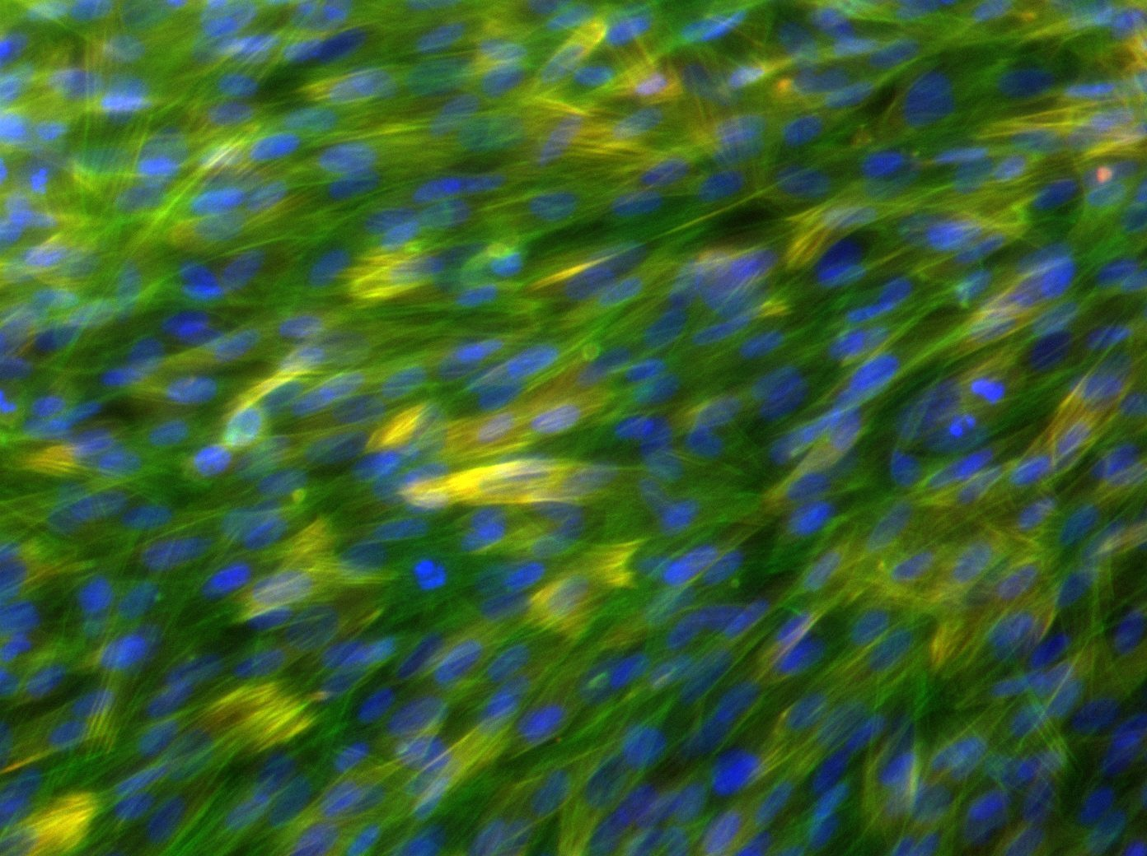
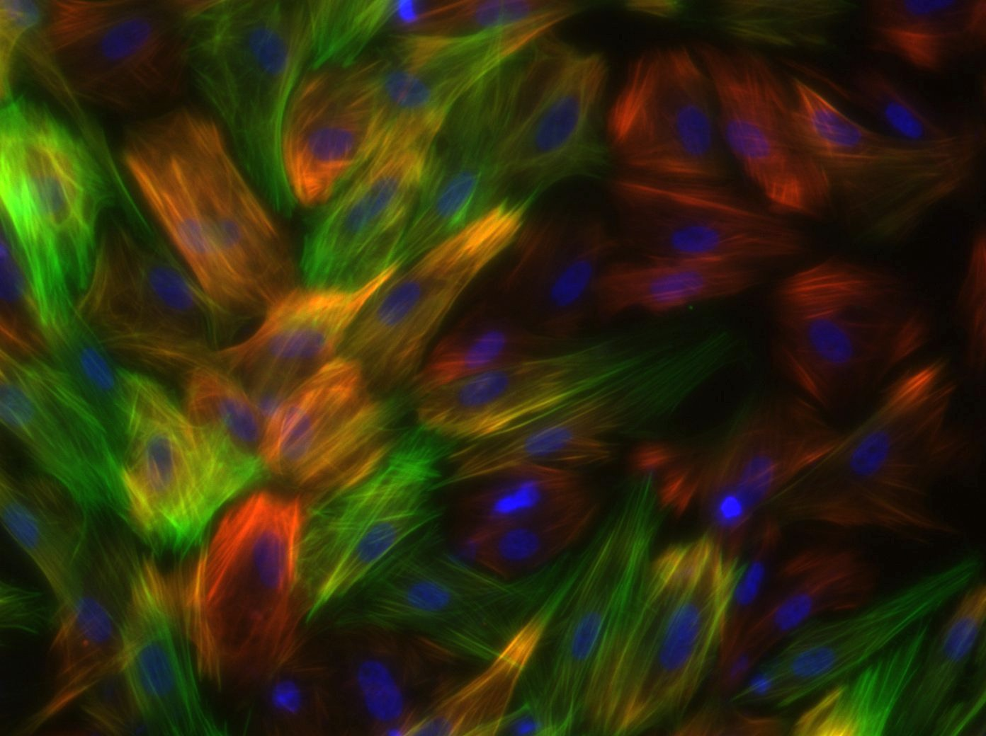
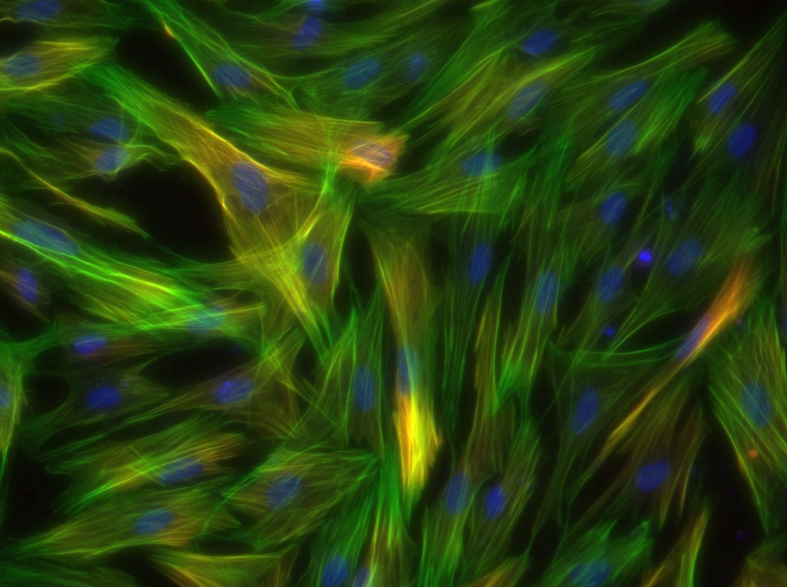
iMSC-G
iMSC-B
iMSC-T
G
B
T
E
*
*
*
Figure 2. Characterization of G, B, and T iMSCs on day 4. A) Bright field images showing morphology at 4X magnification B) Analysis of EdU assay, *p < 0.05, two way T-Test C) Analysis of PrestoBlue assay, *p < 0.05, two way T-Test D) Cells were stained for calponin (red, top & bottom), phalloidin (green, middle & bottom), and DAPI (blue) and imaged at 20X magnification E) qPCR analysis for α Smooth Muscle Actin, Calponin, Elastin, and Caldesmon, *p < 0.05, two way T-Test

Slide 7
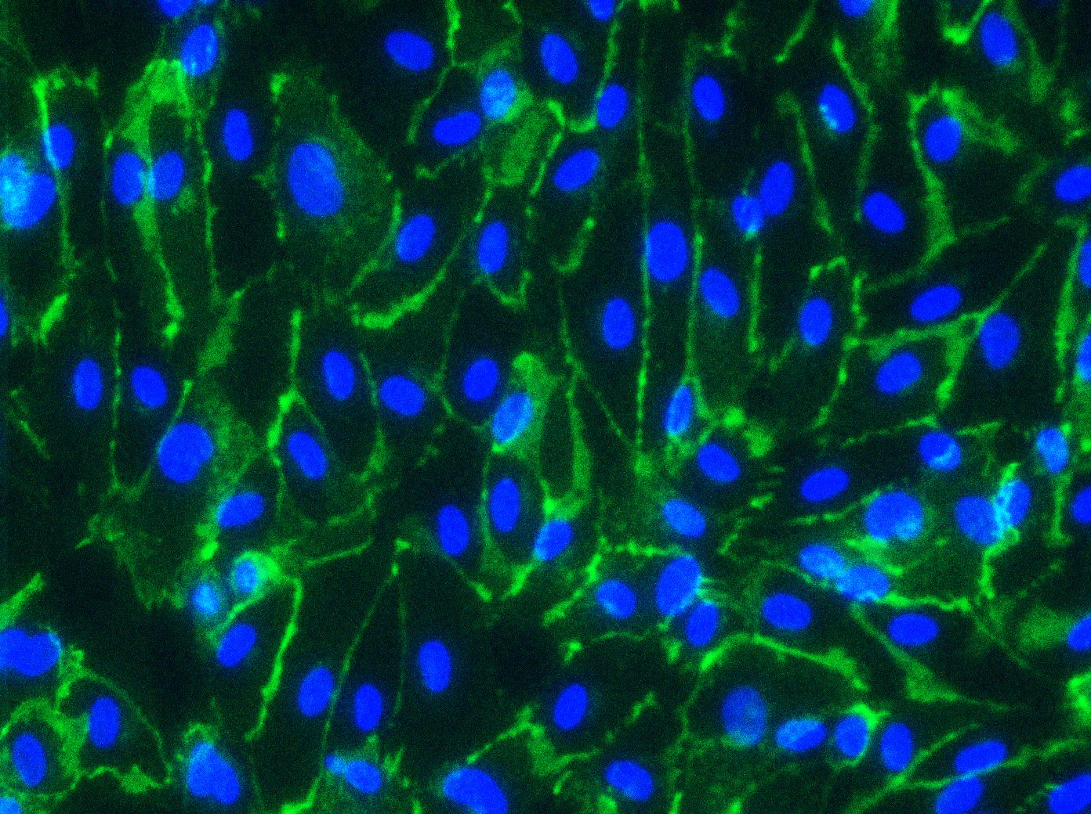
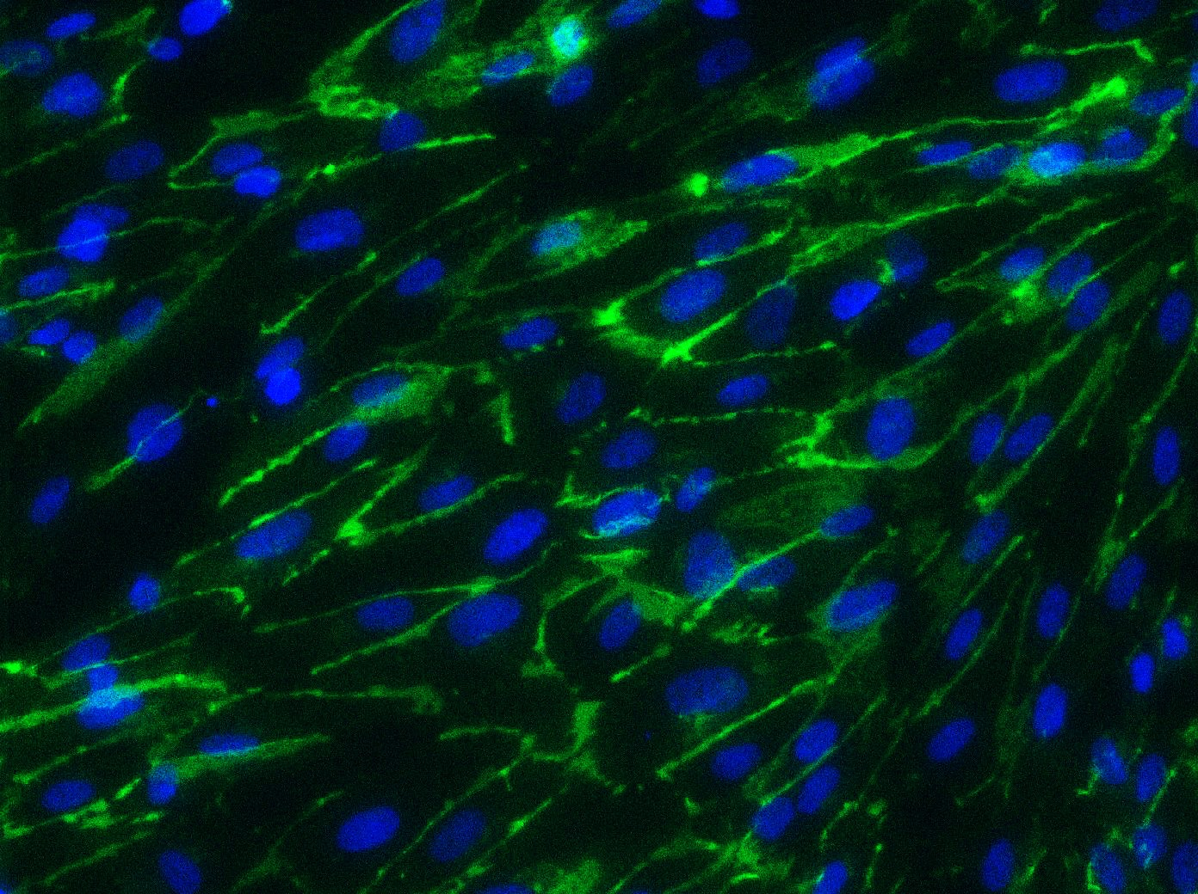
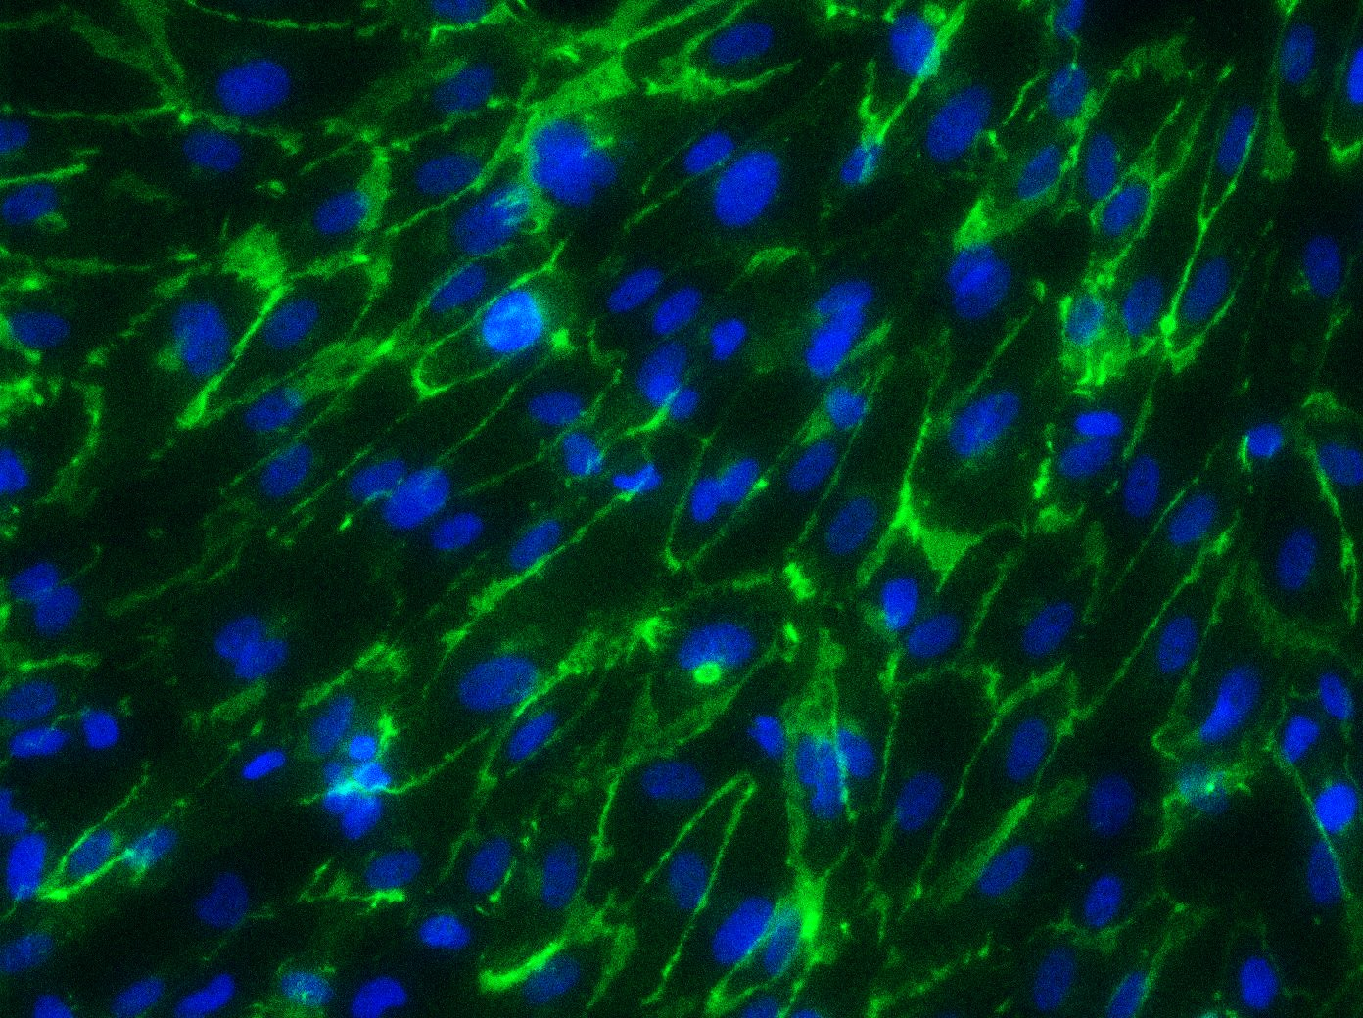
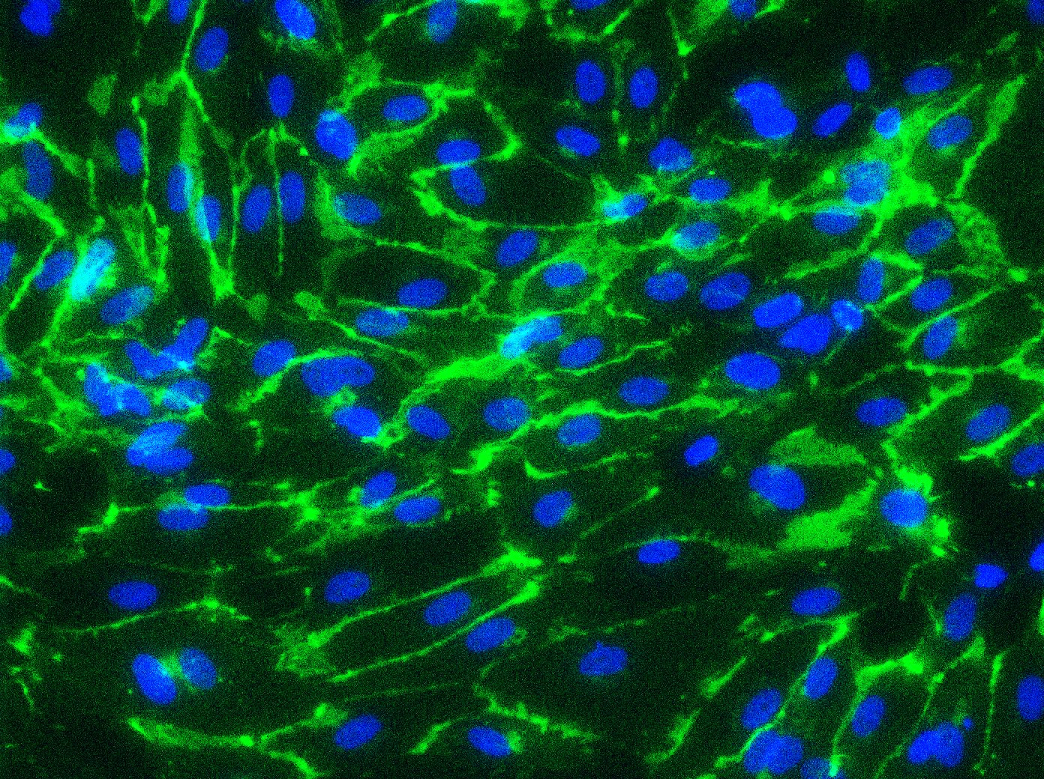
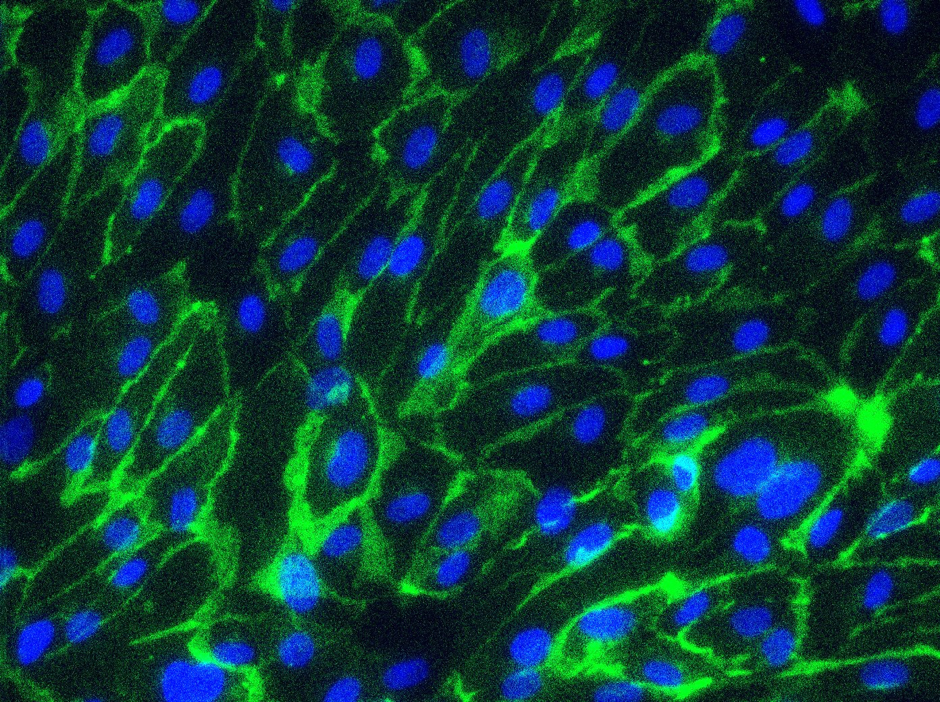
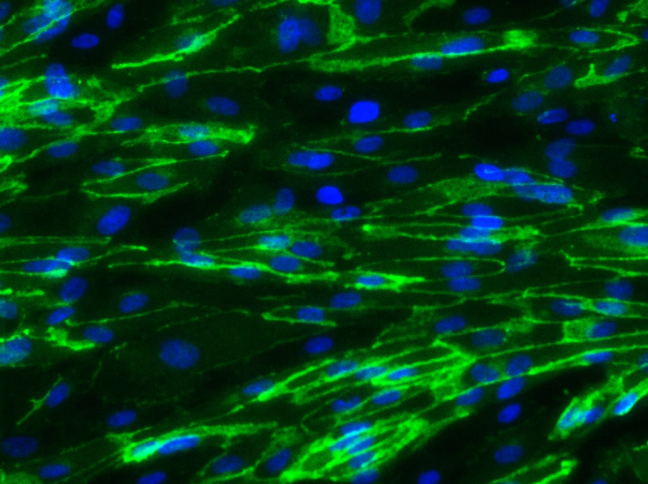
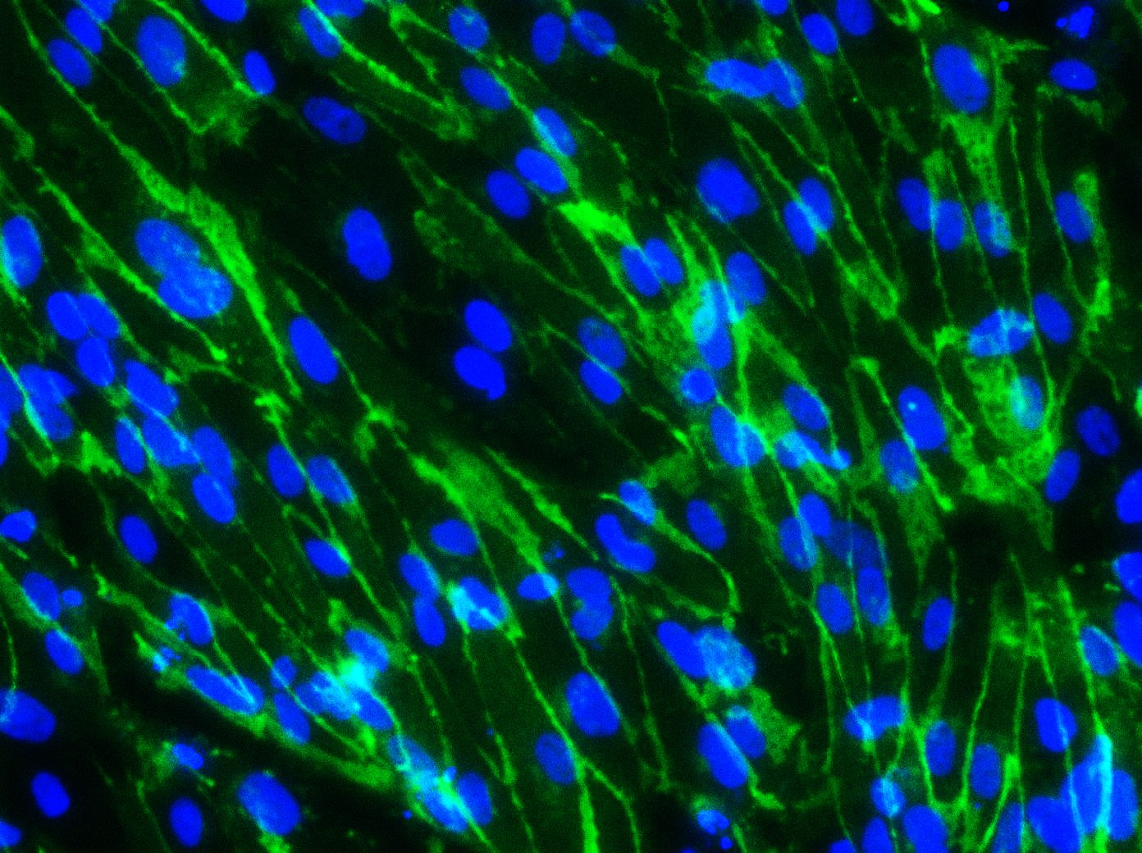
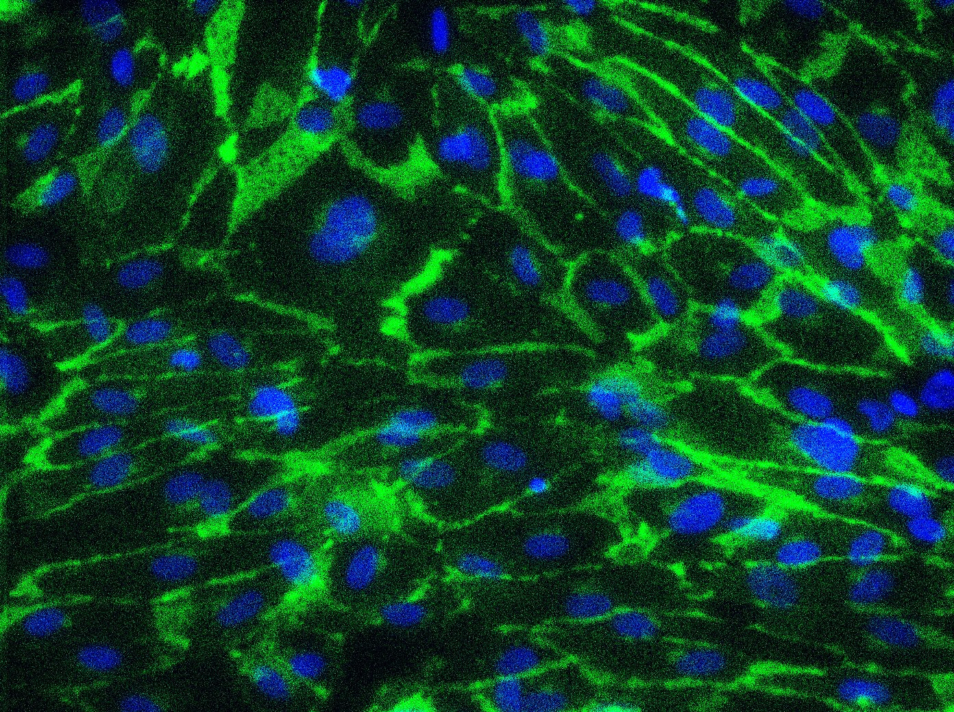
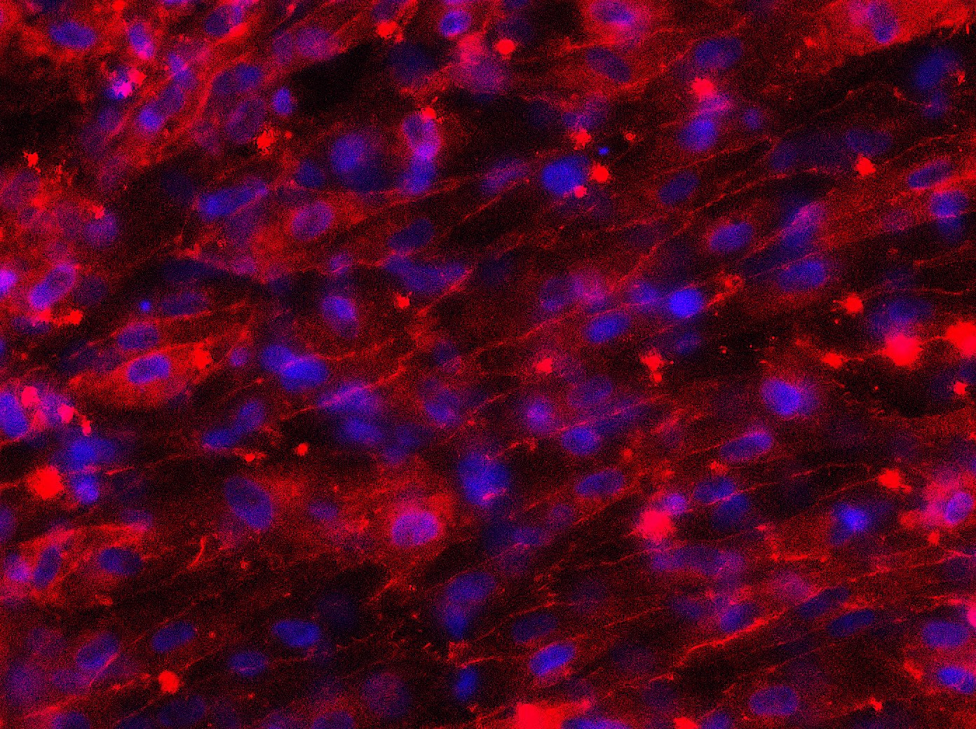
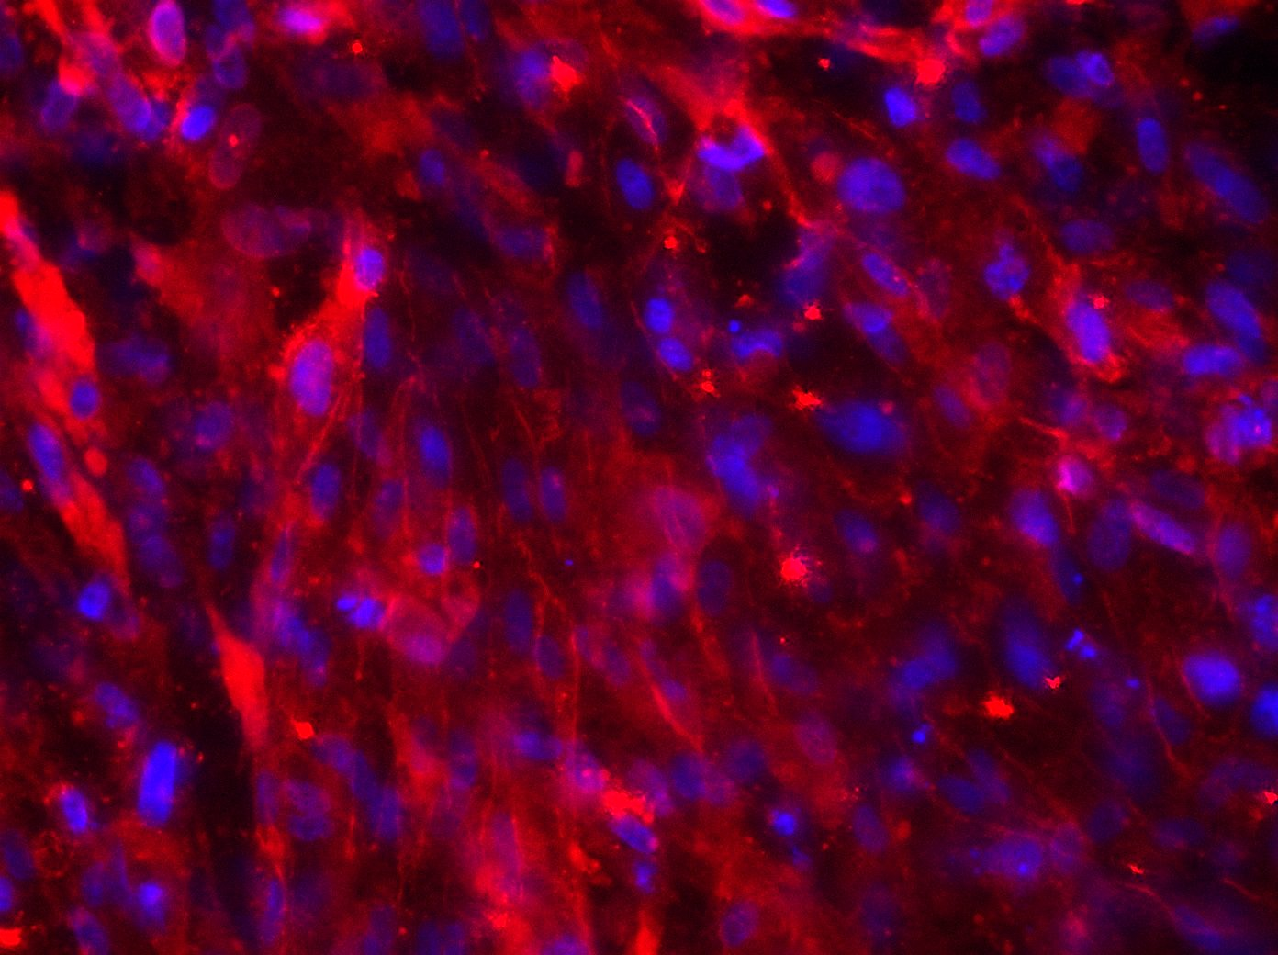
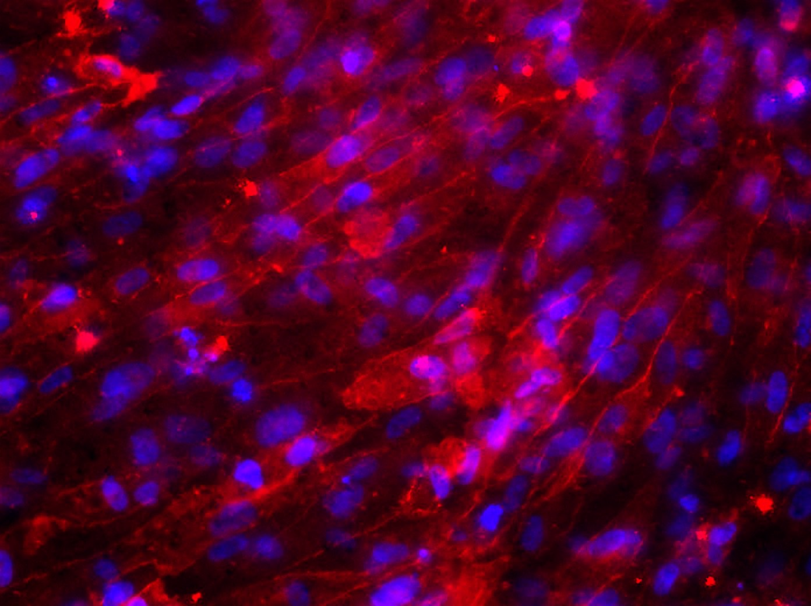
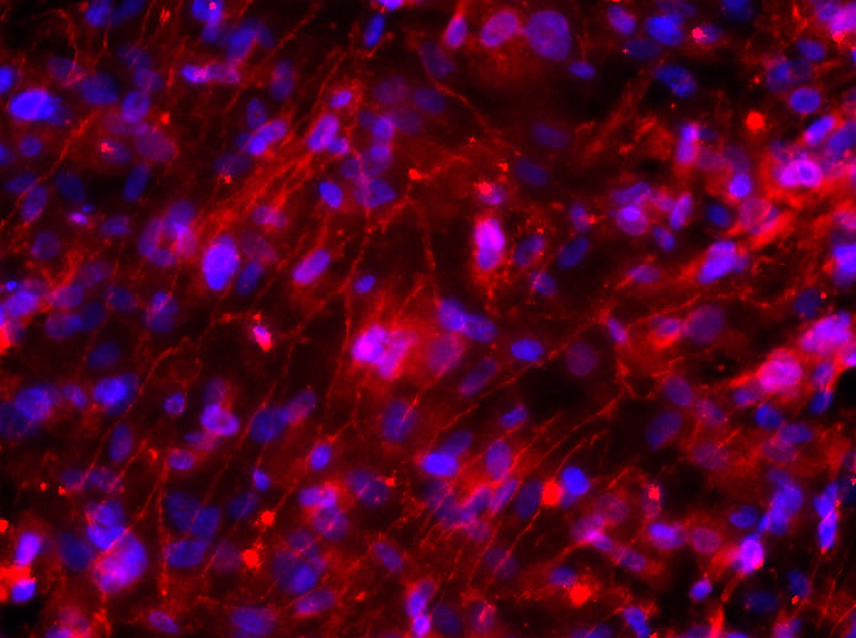
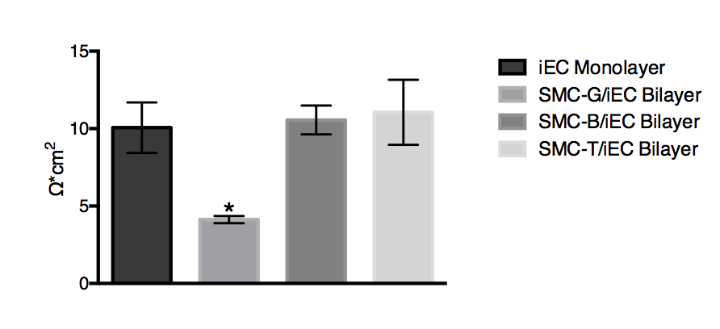
iEC-G
SMC-G-Cond
SMC-B-Cond
SMC-T-Cond
iEC
Monolayer
SMC-G/iEC Bilayer
SMC-B/iEC Bilayer
SMC-T/iEC Bilayer
DIVI D13
Notes:
Top is vecad/dapi
Middle is zo1/dapi(top control, bottom divi)
Include iEC monolayer as a control to see how it either helps or hinders
Bottom is phalloidin/dapi (top control, bottom divi)
3 separate figures

Slide 8







iEC-G
iMSC-G-Cond
iMSC-T-Cond
iEC
Monolayer
iMSC-G/iEC Bilayer
iMSC-T/iEC Bilayer

